Slide 1
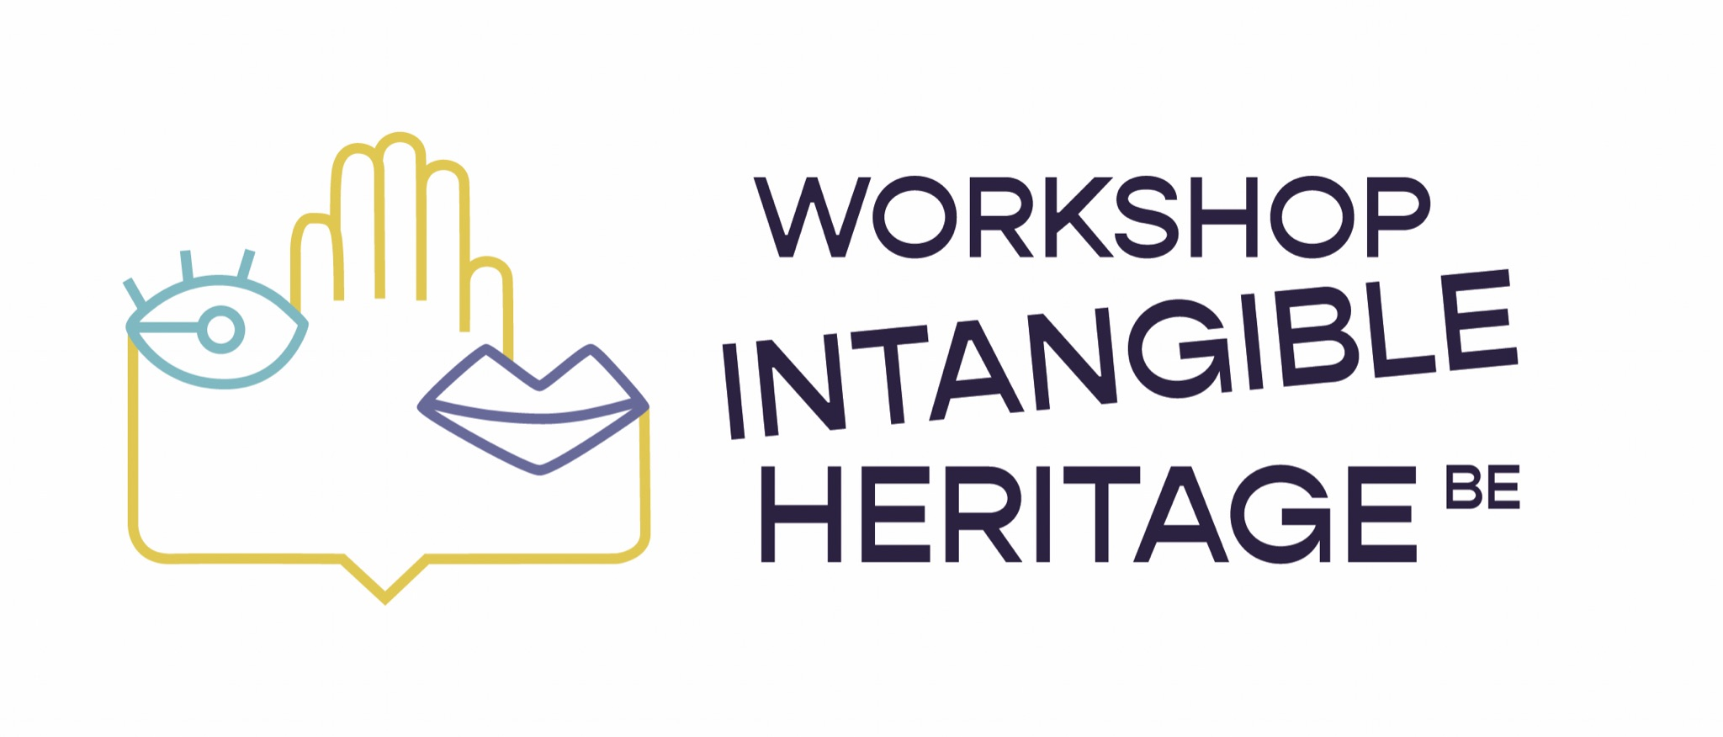
WORKSHOP CIDOC AMSTERDAM
Shaping Standards: Registering Intangible Heritage
Collaborative Feedback & Development
Evdokia Tsakiridis

Slide 2
The publication ‘An application profile for recording ICH in museums’ collection management systems’ was presented during last year's CIDOC 2023 conference.
What has shifted since? What new perspectives, ideas and commentaries can enrich and complement the way living heritage can be part of museum operations?
During this round table we discuss the way forward towards achieving working processes in museums that balance standardization of information with the dynamic nature of intangible heritage.

Slide 3
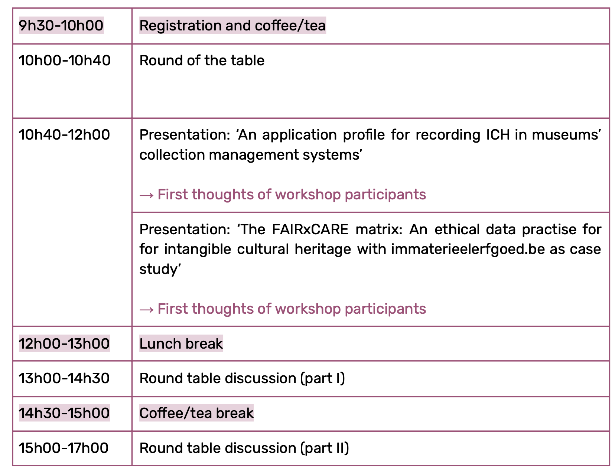

Slide 4
Round of the table
Who are you? What is your affiliation?
What is your connection to CIDOC?
What is your connection to intangible cultural heritage?
What is your connection to museum collection’s management?
Did you have the time to review the documents that were provided?

Slide 5
An application profile for recording intangible cultural heritage in museums’ collection management systems

Slide 6
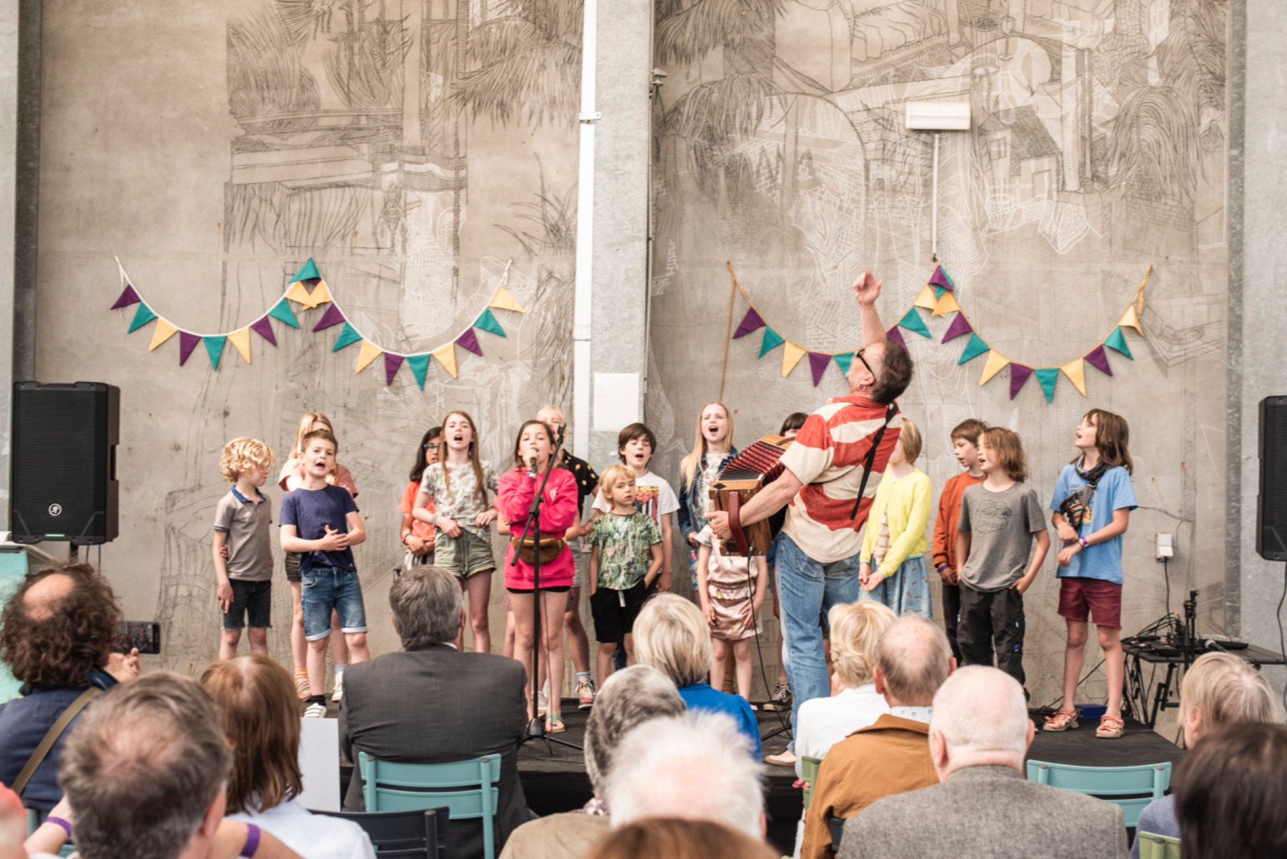
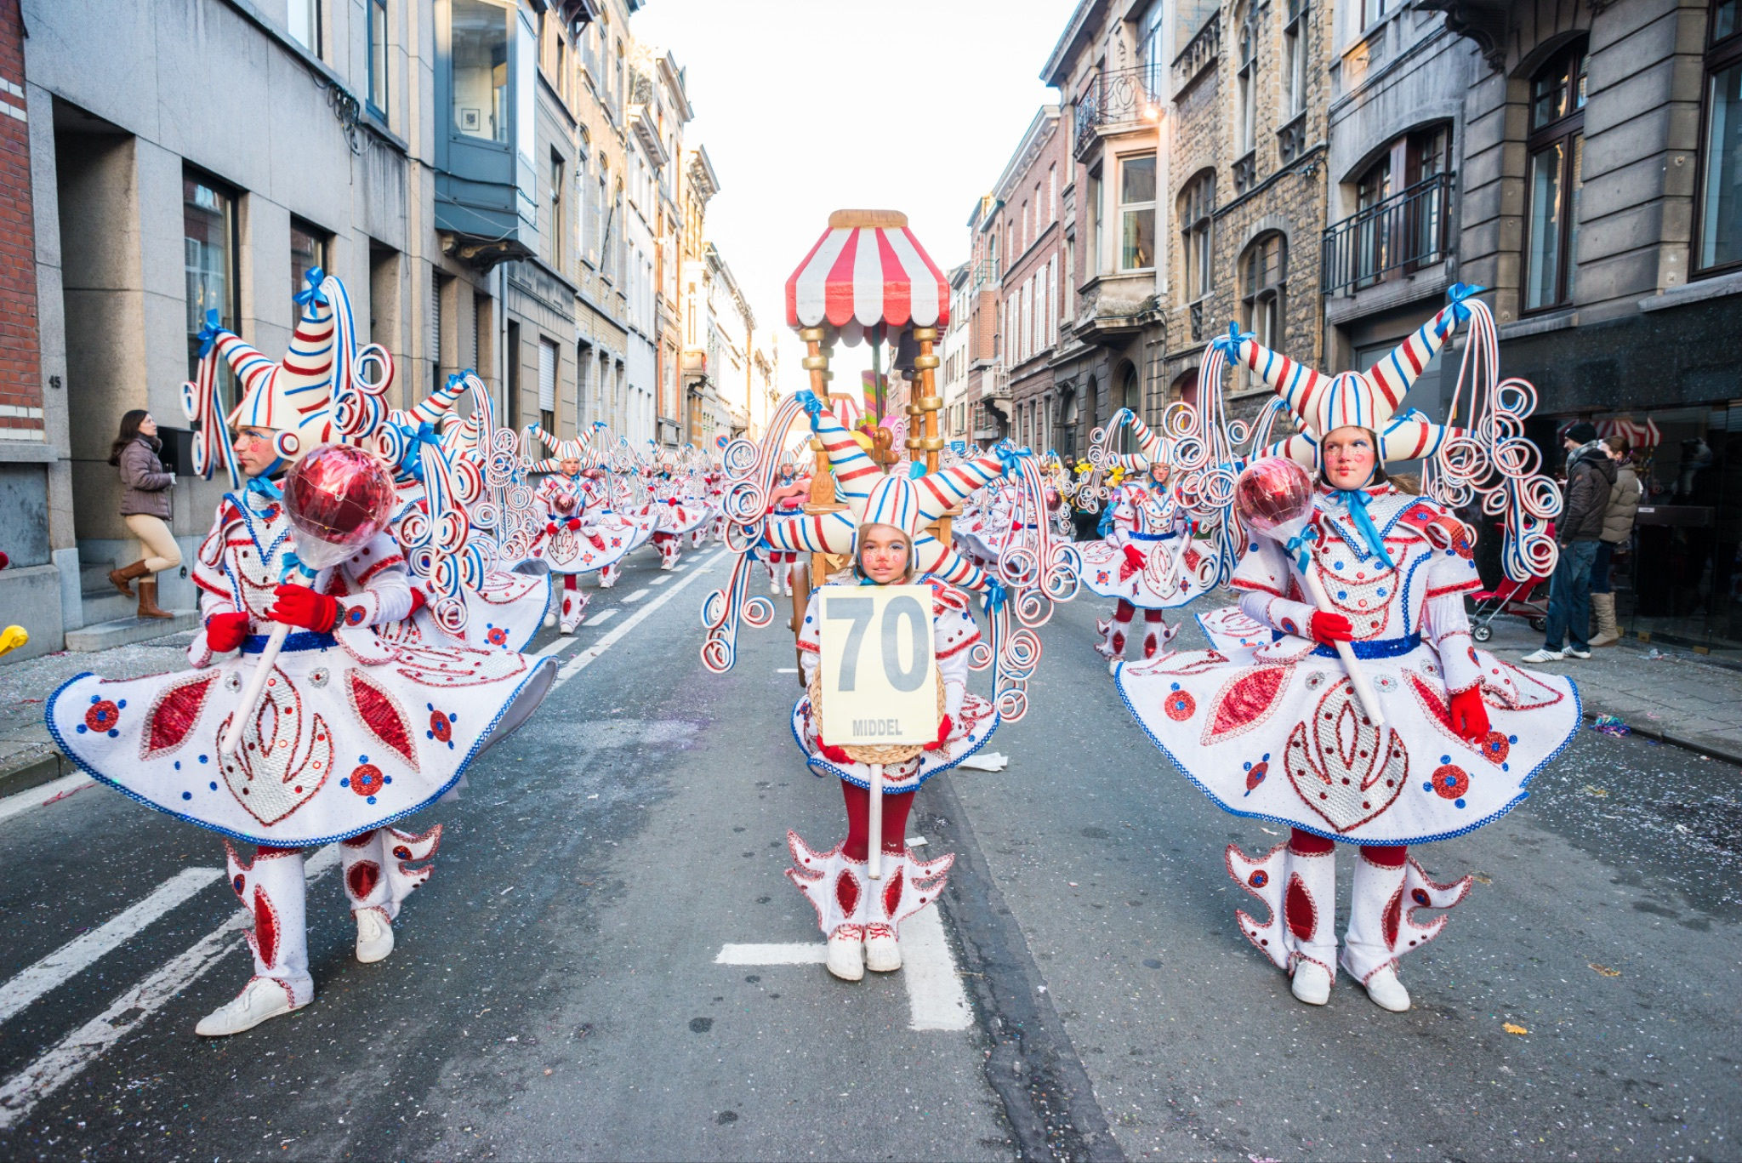
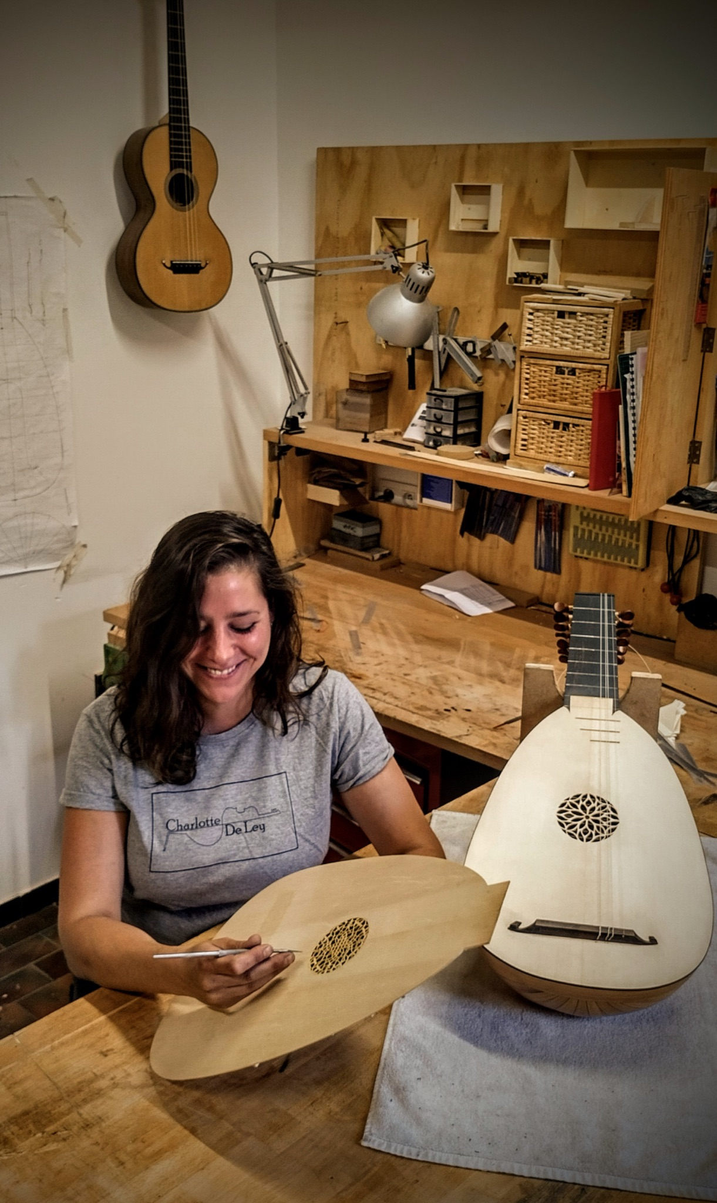
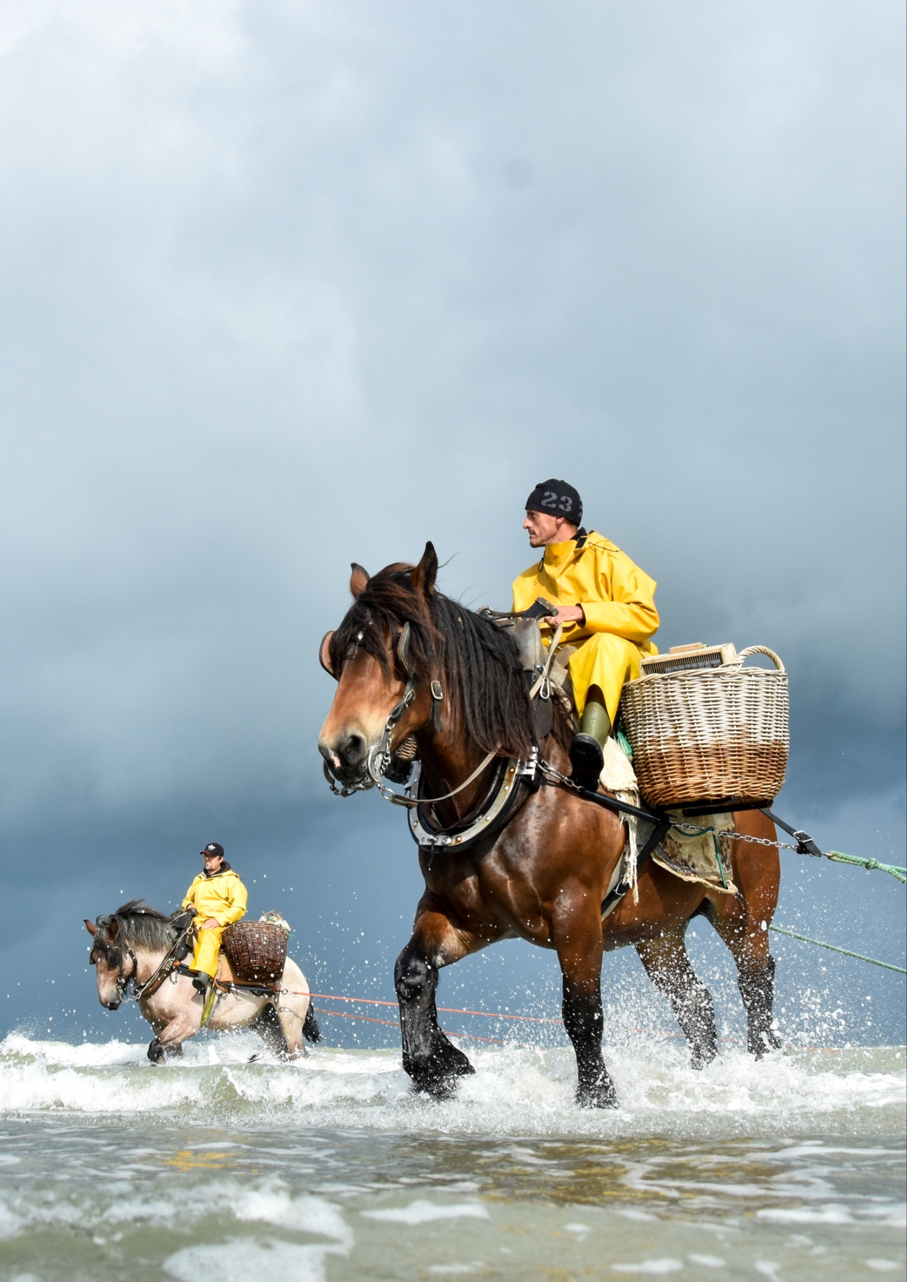
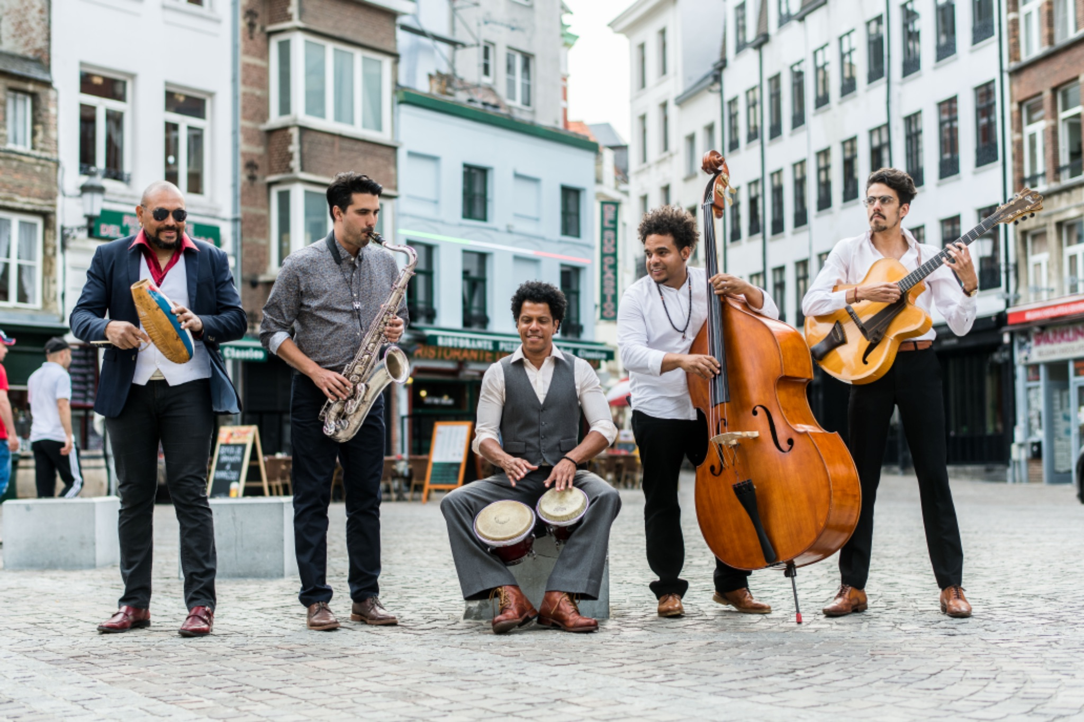
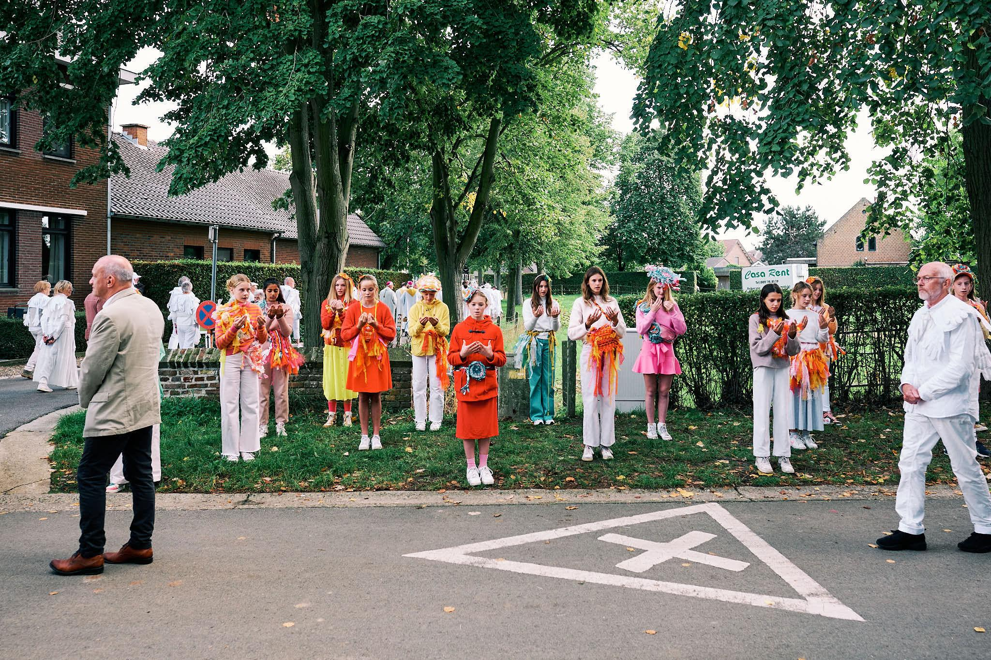
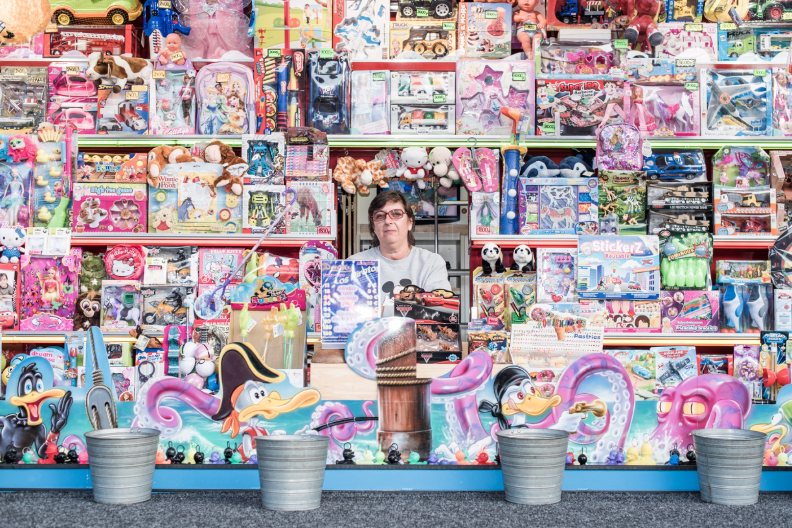
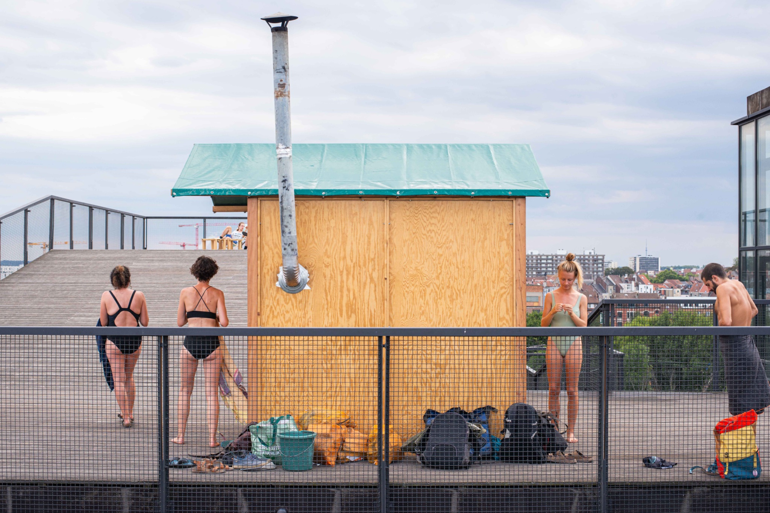
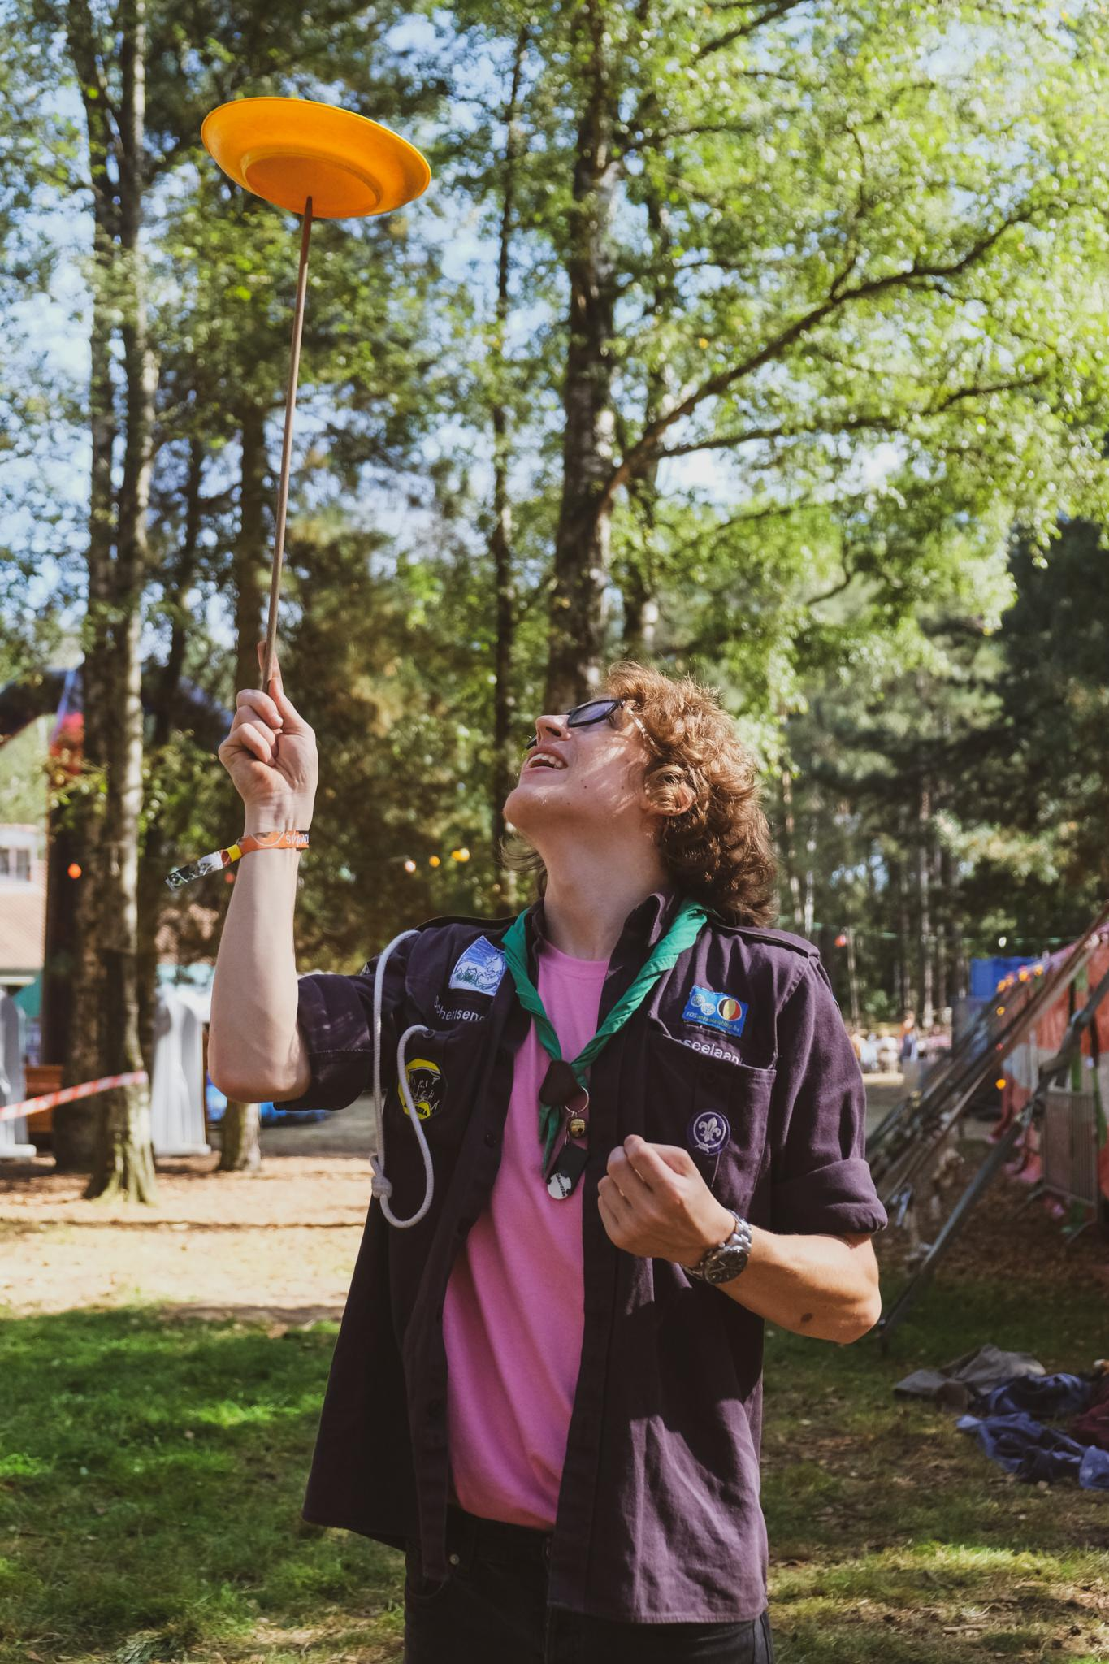
INTANGIBLE CULTURAL HERITAGE?
Photo credits: 1 Femke den Hollander for Workshop Intangible Heritage (WIH) - 2 Lucas Denuwelaere for WIH - 3 Charlotte De Ley - 4 Ann Dujardin - 5 Dries Luyten - 6 Bas Bogaerts for WIH - 7 Studio segers for WIH - 8 Femke den Hollander for WIH - 9 Lucas Denuwelaere for WIH - 10 Open Scouting Daan Vandepitte
Notes:
Conventie
Definitie immaterieel erfgoed, met oa de verschillende domeinen & nadruk op veranderlijk, dynamisch, eigentijds
CGI als primaire custodians - niet een erfgoedinstelling
Vlaams beleid rond immaterieel erfgoed
Verschil met andere types erfgoed
For a common understanding: in this trajectory we define ICH as it is understood in the 2003 UNESCO Convention on safeguarding intangible cultural heritage. This heritage
It is living and dynamic
Transmitted from generation to generation
Communities, groups and individuals who practice and transmit ICH at the core of all safeguarding endeavours
Its ever changing, in interaction with the envirment people live in
It is divided into five inter alia domains
oral traditions and expressions
performing arts
social practices, rituals and festive events
knowledge and practices concerning nature and the universe
traditional craftsmanship

Slide 7
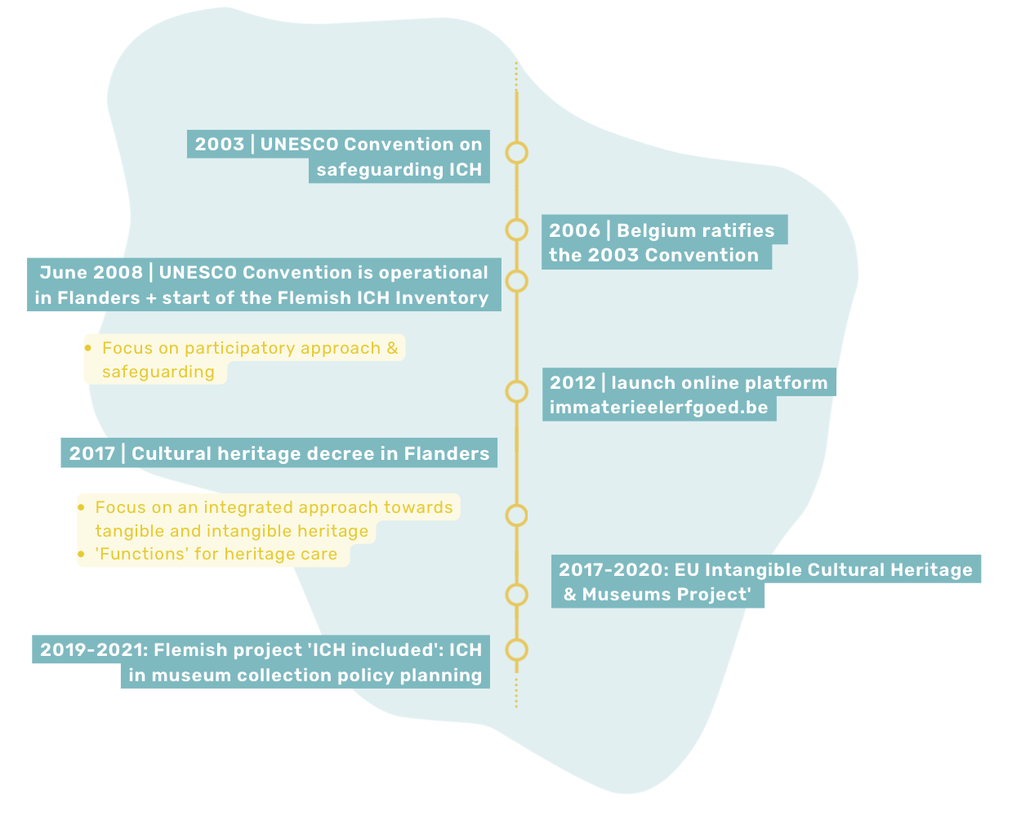

Slide 8
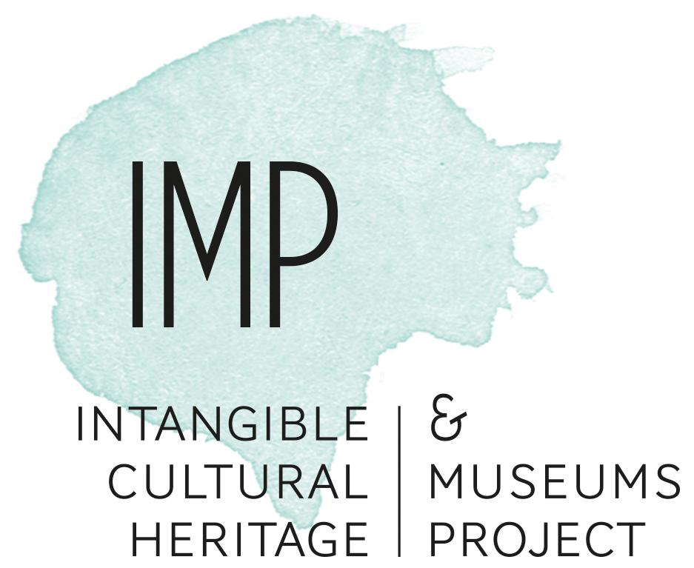
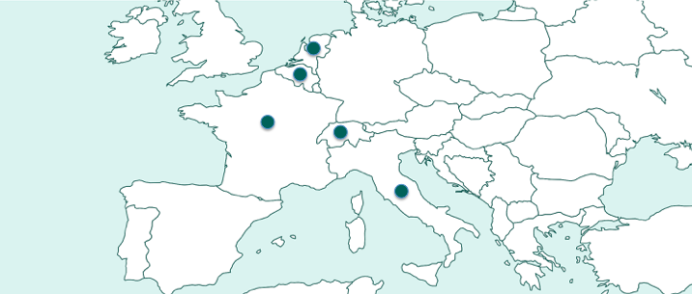
From 2017 to 2020 the project explored the variety of approaches, interactions and practices on safeguarding ICH together with museums…
… with keynotes, position papers, inspiring examples, workshops, debates, panels with ICH-practitioners, co-creations, networking …
ICHANDMUSEUMS.EU

Slide 9
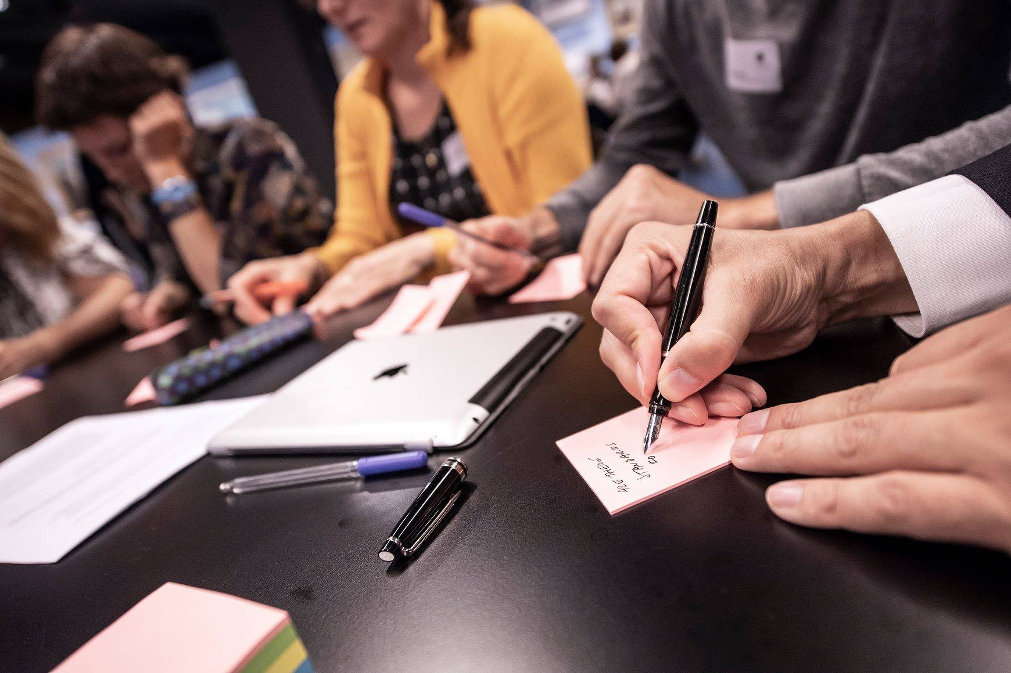
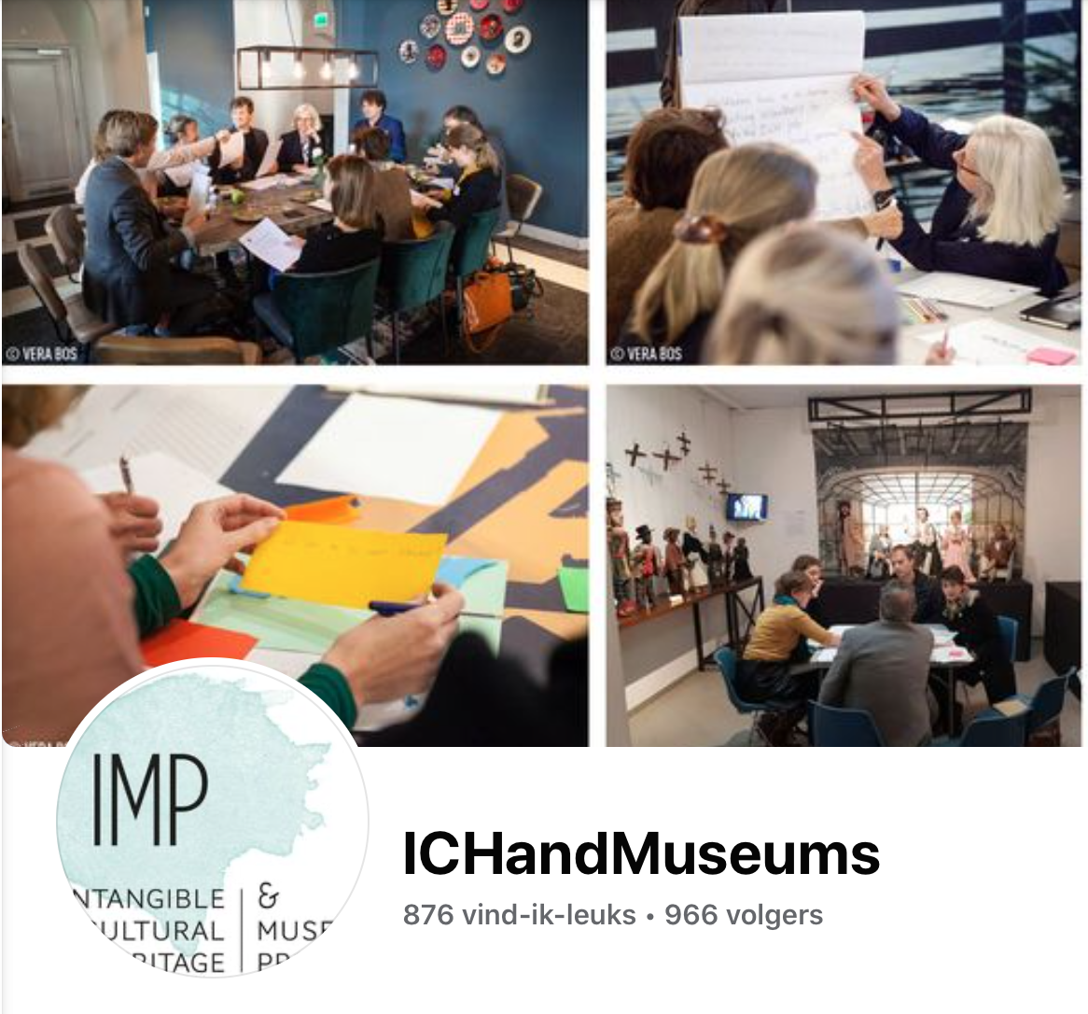

Slide 10
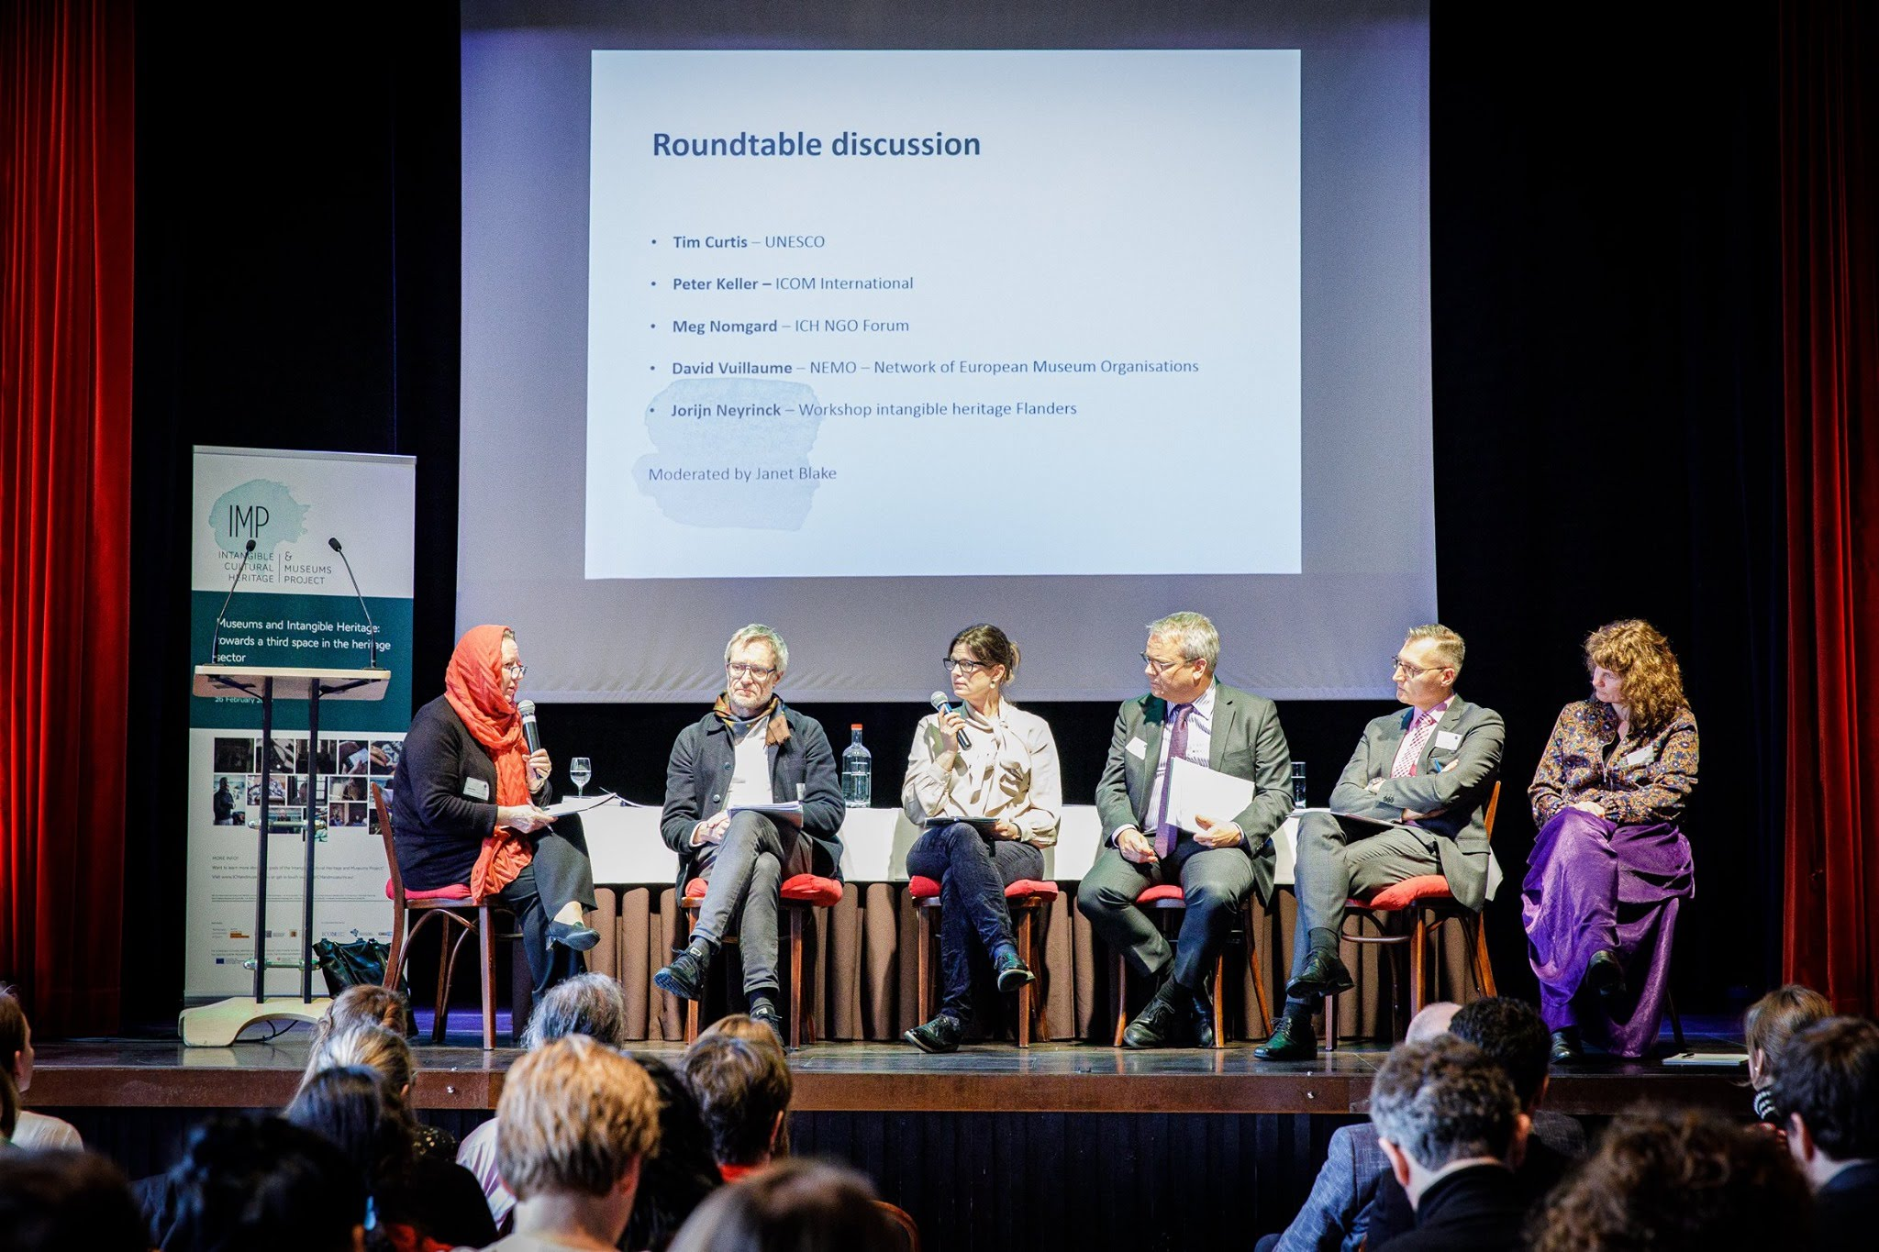
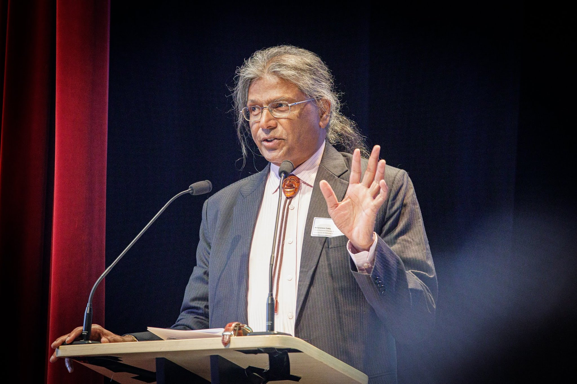
Concluding Symposium ICH & Museums Project (2020)
Keynote speech by dr. Amareswar Galla -
‘Discursive crossings in liminal spaces’
Photos: Sophie Nuytten for
Workshop Intangible Heritage

Slide 11
Notes:
Kijken waar de twee werelden elkaar ontmoeten – op beleidsvlak en op praktisch vlak

Slide 12
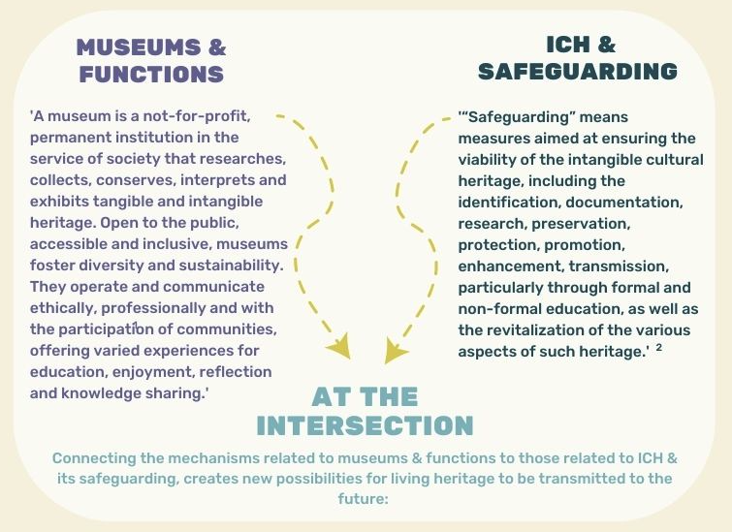
Notes:
TRANSFORMING AND COMBINING SHARED APPROACHES
We propose pooling together exesting methods, skills, know how, expertise, from everybody involed – combining the approaches from the museum field, with the approaches that are common place in safeagurding ICH - with safeguarding this heritage as our main concern
This visual is based on the ICOM museum defintion & the safeguarding measures from the unesco 2003 Convention
With the idea that – in the middle of this cross section – new or approved – methods for heritage care can come about

Slide 13
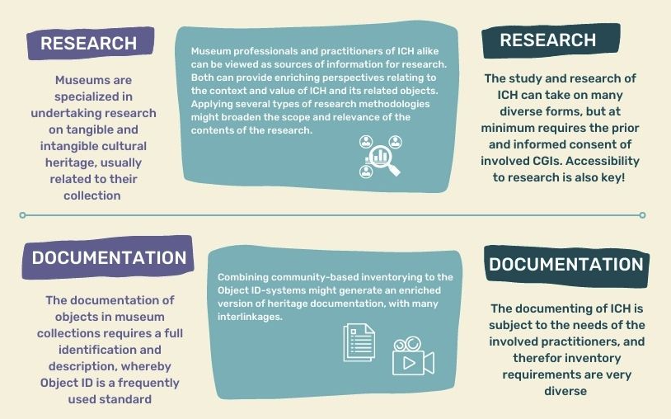
Notes:
Two examples
One on research for example – voorlezen
And another one on documentation – voorlezen

Slide 14
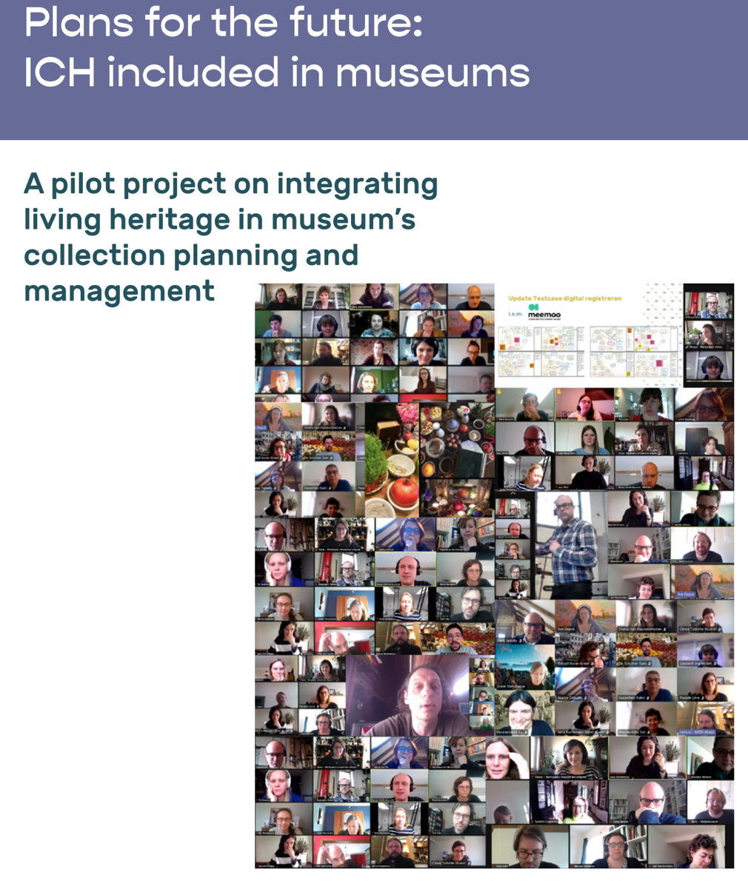
Notes:
After the EU IMP-project we continued with another one that focussed of the aspect of ICH in collection policy plans, with a series of 25 flemish museums
They identified the abscence or impossibility to adequatly decribe ICH in their collection management systems and a big treshold for developing their work and policies on ICH
If practices of ICH are not – in some sort of fashion – part of the museums’ collection (even if museums cannot actually ever own this ICH) its often difficult to ‘justify’ working on ICH.
So we would have to attribute a certain status to ICH practices in museums’ collection management systems, whilst documenting them.
Out of this project, the report that i am presenting, has emerged

Slide 15
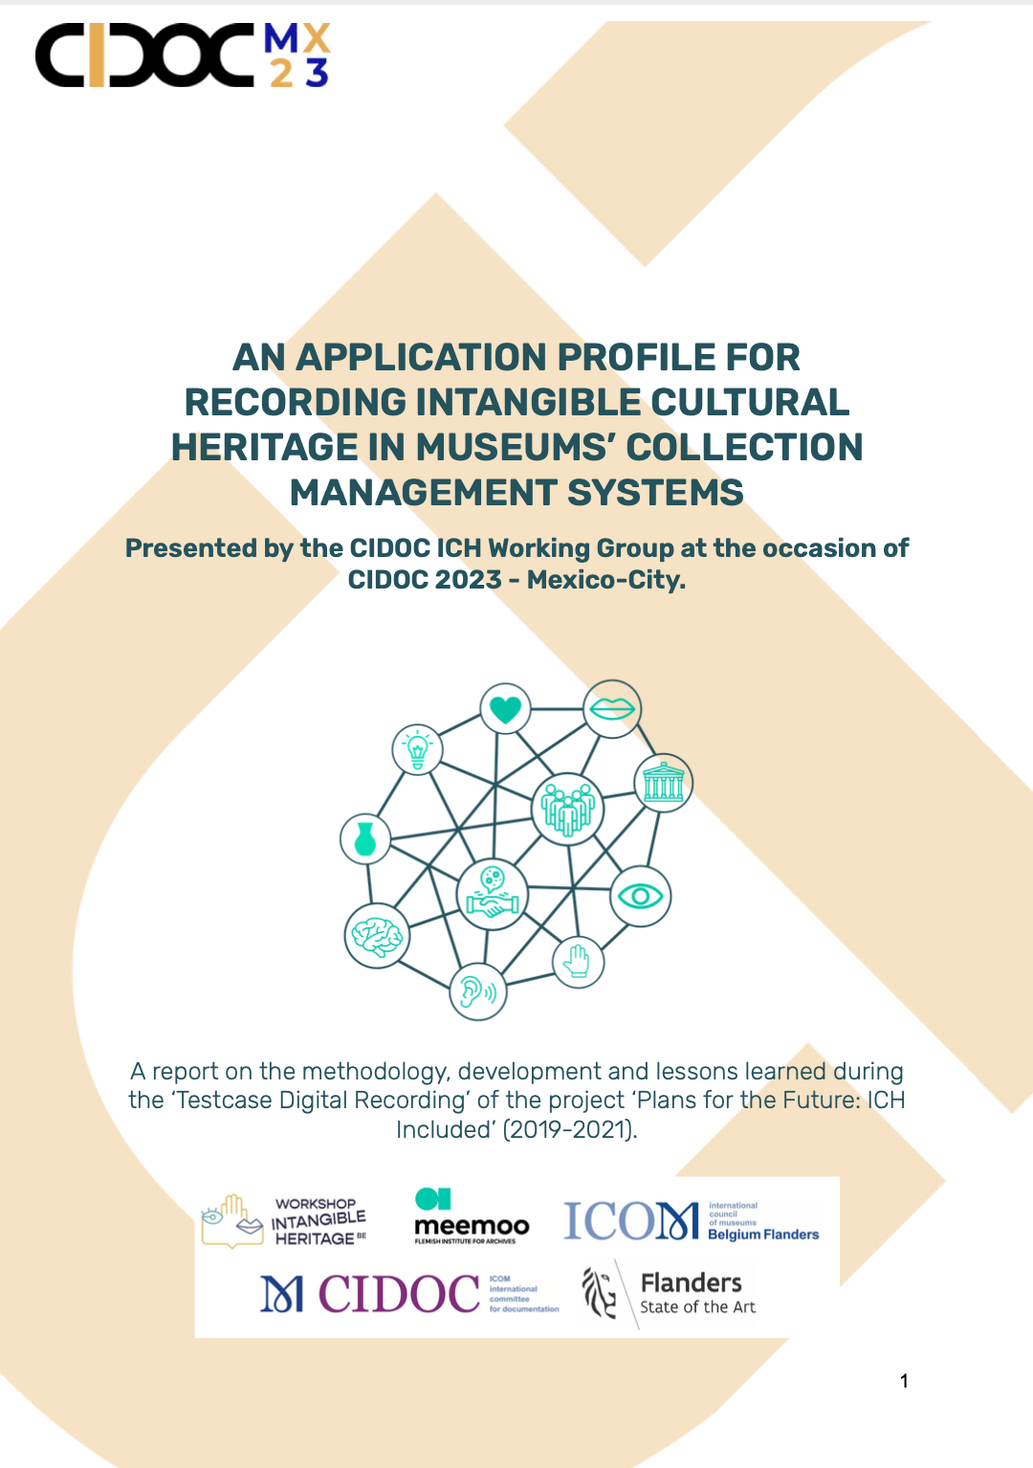
“Safeguarding intangible heritage in museum contexts remains an underexplored domain. One threshold is the inability of current methodologies used for registering this heritage in collection management systems.”

Slide 16
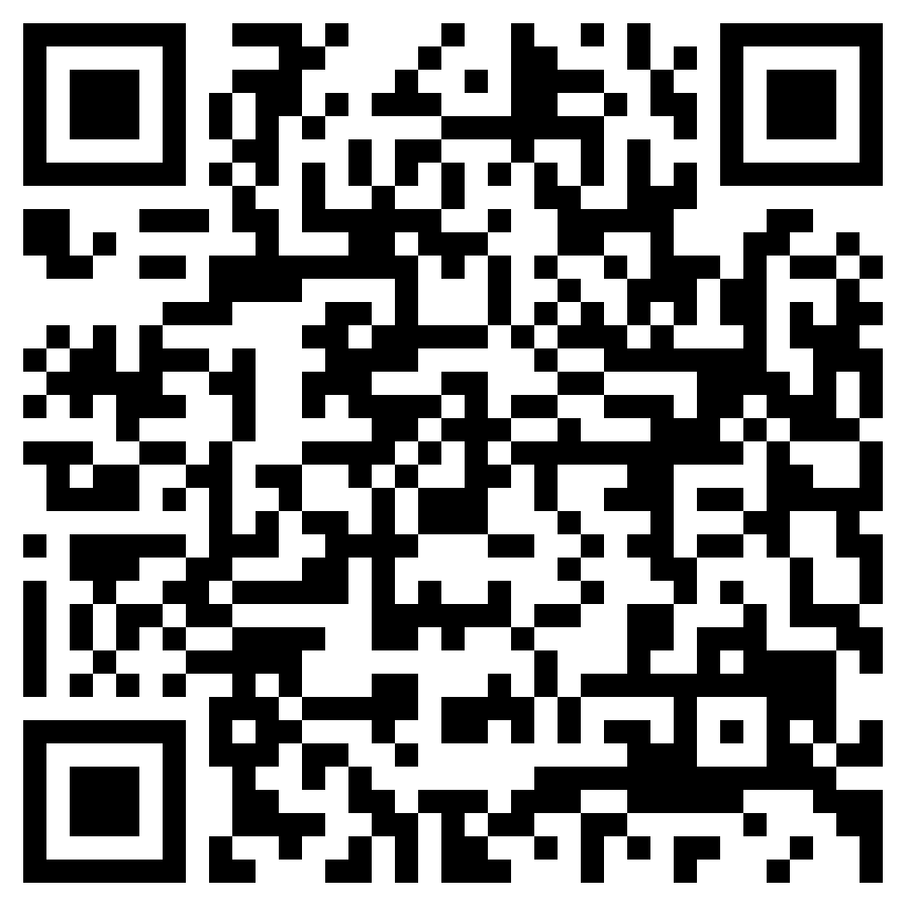

Slide 17
.PROPOSED APPROACH
A first theoretical pillar: studying the need and gains for museums in integrating intangible heritage into their operations
A second and third methodological pillar: developing deontological guidelines and technical solutions
A standard can only be obtained by consensually addressing questions around ownership, collaborative engagement and integration of data.

Slide 18
CHALLENGES
ICH practices need to be documented in their versatility and with attention to their dynamics. It is necessary to record more than just the related collection items and documentation
The necessary interlinkages cannot be made in common collection management systems and in those of other organizations who take up a role in safeguarding ICH.
Collection management systems today do not yet have a tailored translation of concepts, aligned with those commonly used within the context of ICH.
! Free, prior, informed and sustained consent and participation of communities, groups and individuals concerned is primordial, but not common practice…
Notes:
We identified many challenges surrounding the integration of information on ICH practices in museums’ collection management systems - they are diverse and multifaceted

Slide 19
CONSEQUENCES?
Accumulation of different types of media and carriers
Fragmentation and loss of information
…
Notes:
Consequentes of these challenges are
Which is detrimental to the safeguarding of ICH

Slide 20
Blueprint of an application profile, with entities and properties
Cataloguing rules, from within 2 viewpoints
Policy recommendations with minimum requirements
13 proofs of concept
Notes:
so we developed this application profile for ICH in museums collection management systems containing
the technical specifications of an application profile for describing ICH practices, i.c. a list of all entities that the model allows to describe and a list of their interrelationships.
A series of Cataloguing Rules - containing two sets of rules for ICH practices, starting from from two different perspectives:
a collection manager describing a collection item and the practices of ICH associated with it
an expert or practitioner of ICH describing a specific manifestation of an ICH practise
And Policy Recommendations - formulating minimum requirements for an institutional policy on cataloguing ICH practices
The first 13 proof of concepts from 13 museums in Flanders

Slide 21
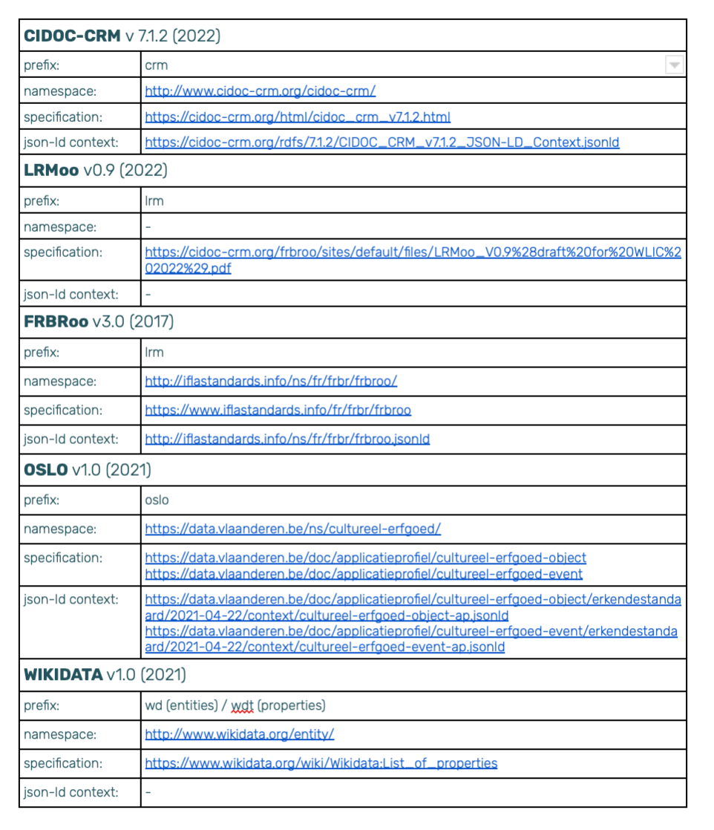
5 STANDARD MODELS
Notes:
All entities have been drawn from five different standard models, for which the English labels have been included as ‘equivalent classes’. These names should be used to serialise the information in a machine-readable format
For this part of the report, we worked together intensively with meemoo. Flemish Institute for Archiving, and especially Bert Lemmens - who also provides a more detailed explation in the video that is featured in one of the following slides, which is available online

Slide 22
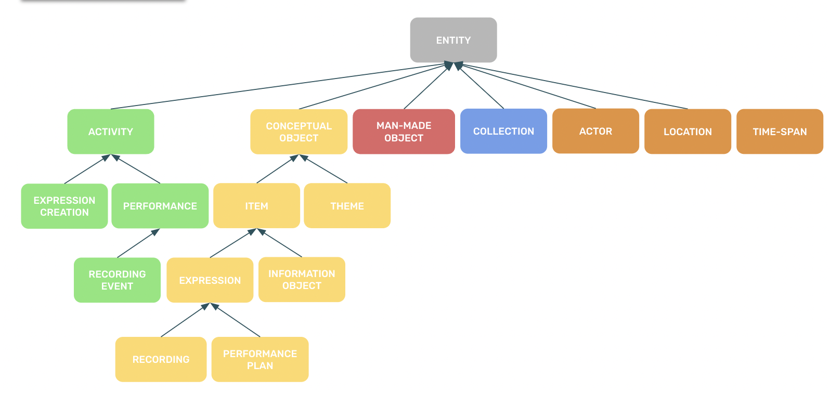
ENTITY HIERARCHY
Notes:
We propose an ENTITY HIERARCHY in the report

Slide 23
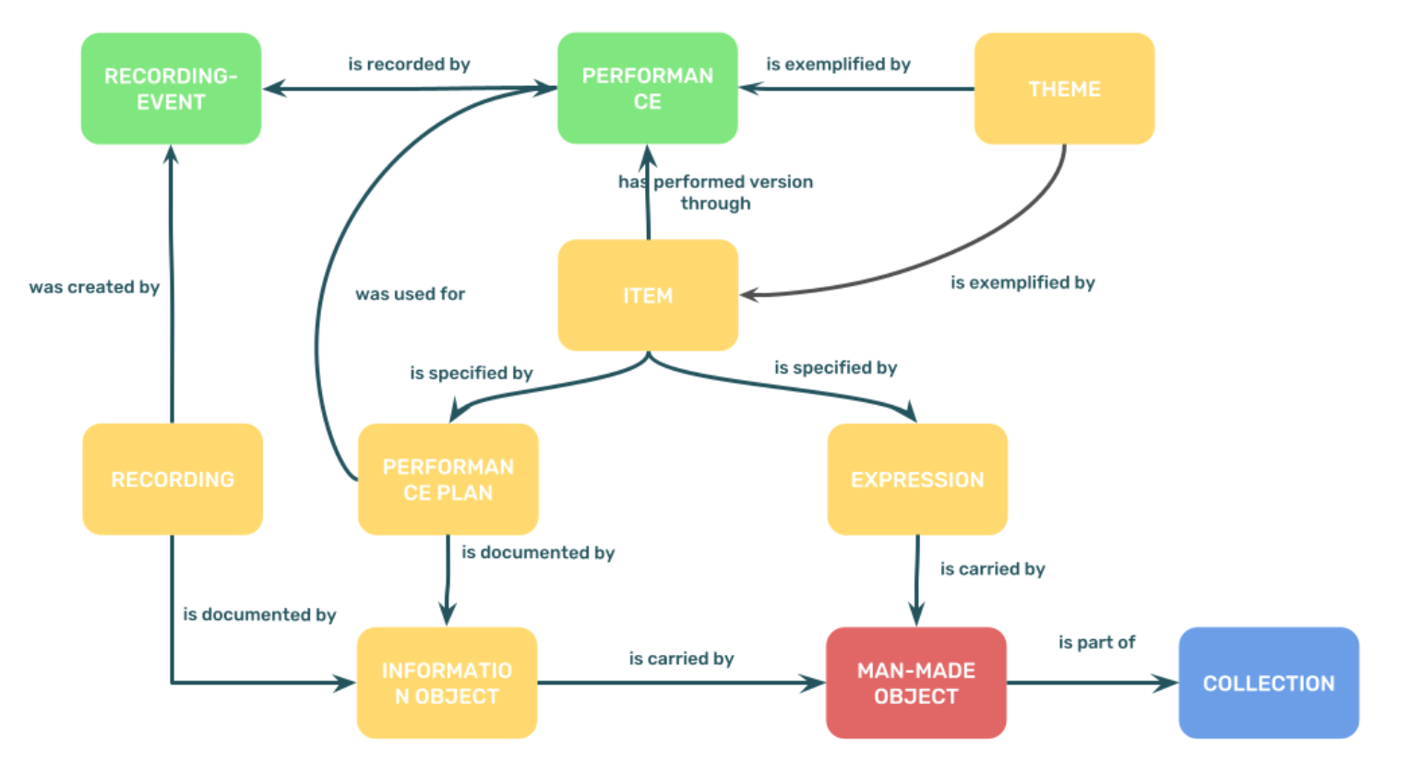
CORE MODEL OF THE APPLICATION PROFILE
Notes:
And a core model of the application profile, including the entities and their corresponding properties

Slide 24
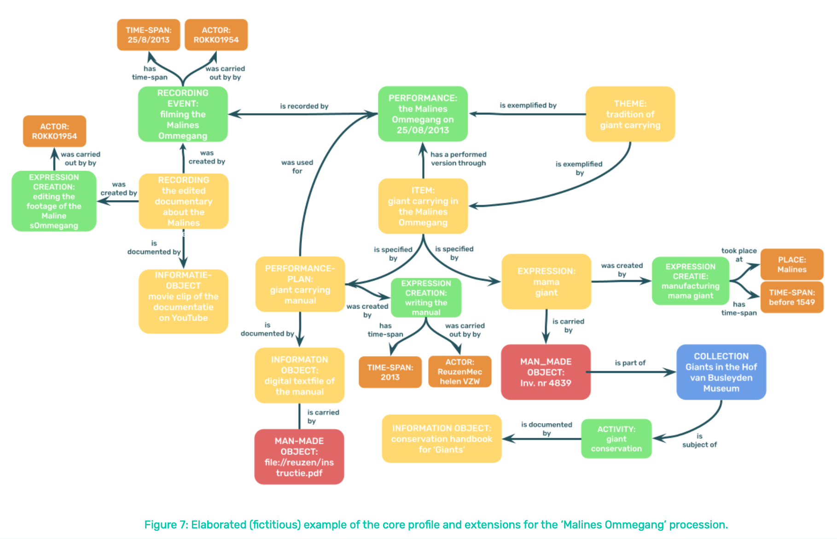
PROOF OF CONCEPT
Notes:
And here you can see one of the proofs of concept,
With the example of the Malines Ommegang, which is a procession

Slide 25
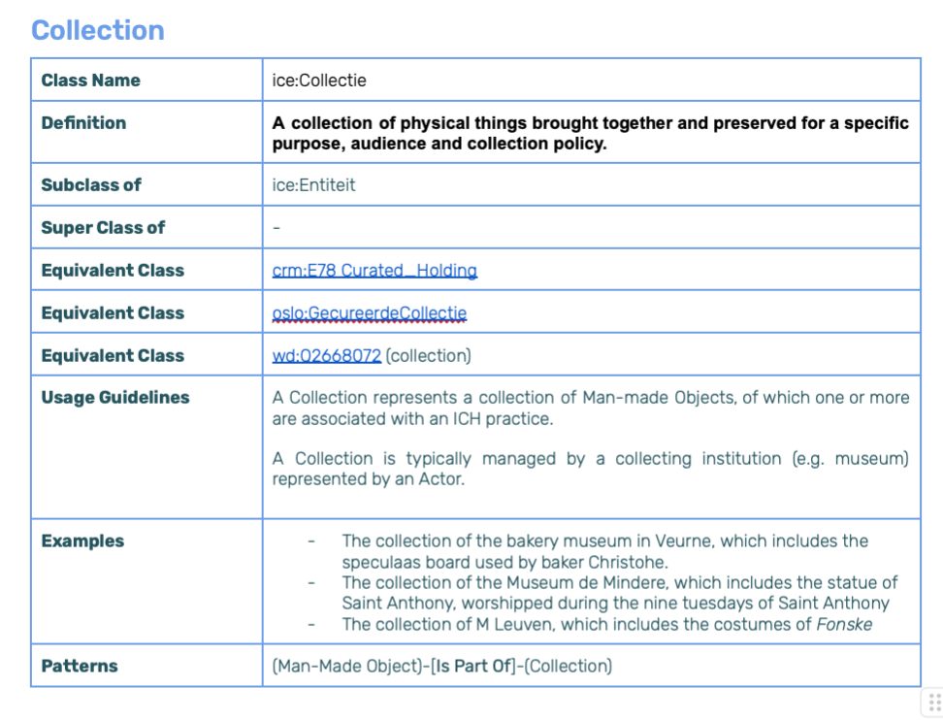
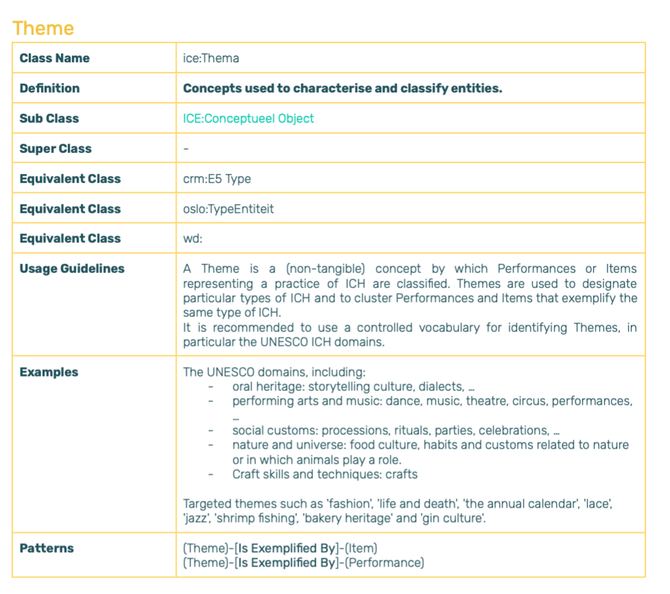
ENTITIES
Notes:
We provided detailed information on the entities, including some examples

Slide 26
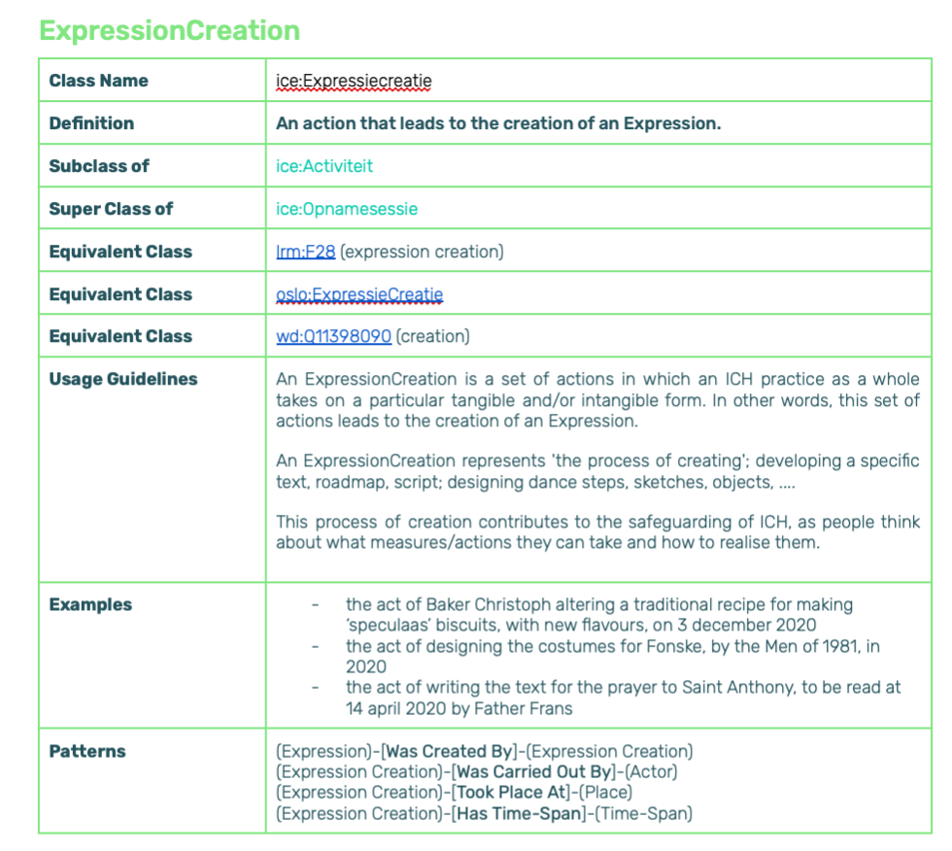
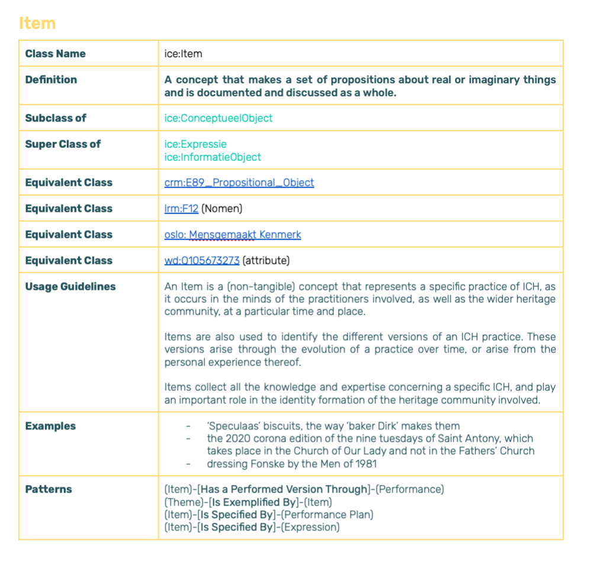
ENTITIES

Slide 27
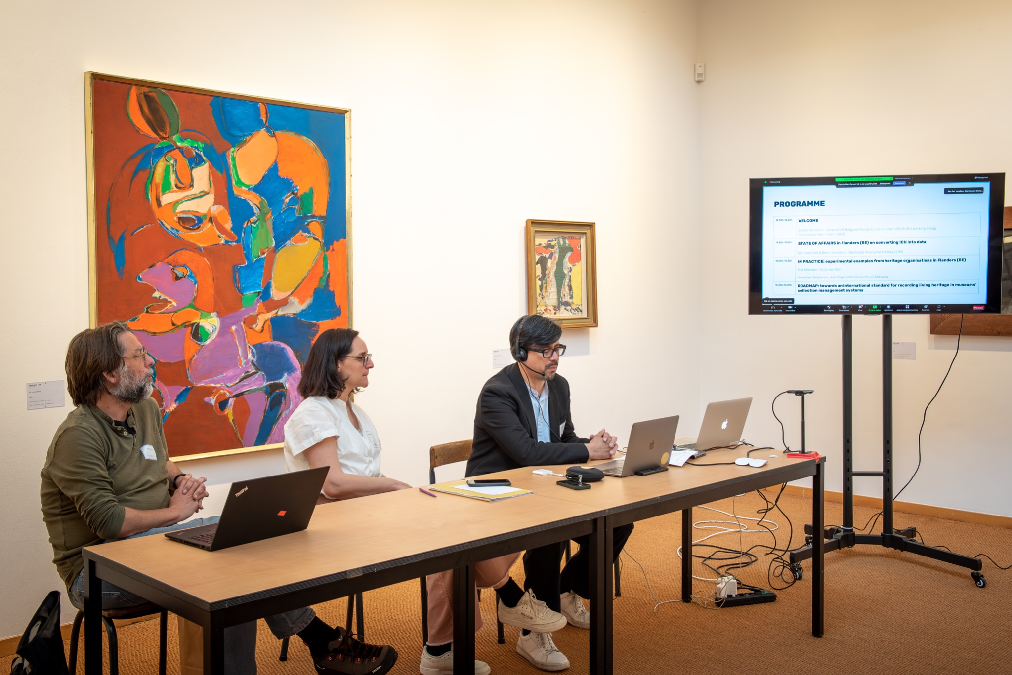
A PREVIOUS SESSION OF THE CIDOC ICH WORKING GROUP
Hybrid Working Group session in May 2023, FeliX Art & Eco Museum. Photo: Tine Van De Vel for Workshop Intangible Heritage Flanders
LINK TO RECORDING
Notes:
And for those among you who are interested in the more technical explanation, we have our colleaegue from the flemish institute for archives – bert lemmens - elaborating on it, in this video

Slide 28
POLICY RECOMMENDATIONS
A policy on documenting ICH in museums requires:
→ a vision on collaborating with communities, groups, individuals that practice and transmit ICH
→ a vision on connecting collection objects with ICH practices
>>> UNESCO Ethical Principles for Safeguarding Intangible Cultural Heritage
>>> SPECTRUM-procedures
Notes:
But prior to even trying to implement this application profile, it is necesasry to develop deontological guidelines for this approach.
According to us, a policy on documenting ICH in museums requires:
→ a vision on collaborating with communities, groups, individuals that practice and transmit ICH
→ a vision on connecting collection objects with ICH practices
We provided 5 policy recommendations, based on …

Slide 29
POLICY RECOMMENDATIONS
Register within a participatory framework
Identify associated practices of ICH
Distinguish between collection items ‘used in’ ICH and collection items that ‘record’ them
Situate ICH practices and their various manifestations in time and space
Document various representations of an ICH practice

Slide 30
CHALLENGES
Collection management systems are not in tune with requirements regarding ICH
ICH often is an afterthought when it comes to data management
Findings still need to be thoroughly assessed and tested by a wide variety of museums, across the globe
Participatory methodologies are time consuming and often complex
...
Notes:
But … many challenges still remain

Slide 31
OPPORTUNITIES
Museums (but also archives etc.) increasingly work on safeguarding ICH with the concerned communities, groups and individuals, at all types of levels in their operations
Communities, groups and individuals who practice ICH are also increasingly realizing the value of their ICH and benefits that might come from collaborating with museums towards safeguarding their ICH
A series of experimental pathways are launched, with a particularly strong interest: from Flanders, to Europe, to the global level
Notes:
But even more important, a whole range of opportunities lies before us, especially when we approach this topic of documenting ICH in museum context from a global perspective

Slide 32
OPPORTUNITIES
Documenting ICH in museums’ collection management systems, linking them a.o. with (intern)national ICH inventories, wiki-platforms, … allows for enriching these inventories and our knowledge about ICH, stimulating research, collaboration, … and above all, the safeguarding of ICH with the communities, groups and individuals concerned!
Notes:
Ook iets over pURI zeggen?

Slide 33
ROADMAP
… towards an international standard for recording living heritage in museums’ collection management systems
TRANSLATION
REPORT
QUESTIONNAIRE
PRESENTATION
CIDOC MEXICO
FORMAL CIDOC MANDATE?
DEFINE AMBITIONS: best practice or ISO?
WS CIDOC AMSTERDAM

Slide 34
First thoughts?

Slide 35
An ethical data practice for intangible cultural heritage
Collecting and linking data on immaterieelerfgoed.be

Slide 36
INTANGIBLE CULTURAL HERITAGE?
Photo credits: 1 Femke den Hollander for Workshop Intangible Heritage (WIH) - 2 Lucas Denuwelaere for WIH - 3 Charlotte De Ley - 4 Ann Dujardin - 5 Dries Luyten - 6 Bas Bogaerts for WIH - 7 Studio segers for WIH - 8 Femke den Hollander for WIH - 9 Lucas Denuwelaere for WIH - 10 Open Scouting Daan Vandepitte
Notes:
Conventie
Definitie immaterieel erfgoed, met oa de verschillende domeinen & nadruk op veranderlijk, dynamisch, eigentijds
CGI als primaire custodians - niet een erfgoedinstelling
Vlaams beleid rond immaterieel erfgoed
Verschil met andere types erfgoed

Slide 37
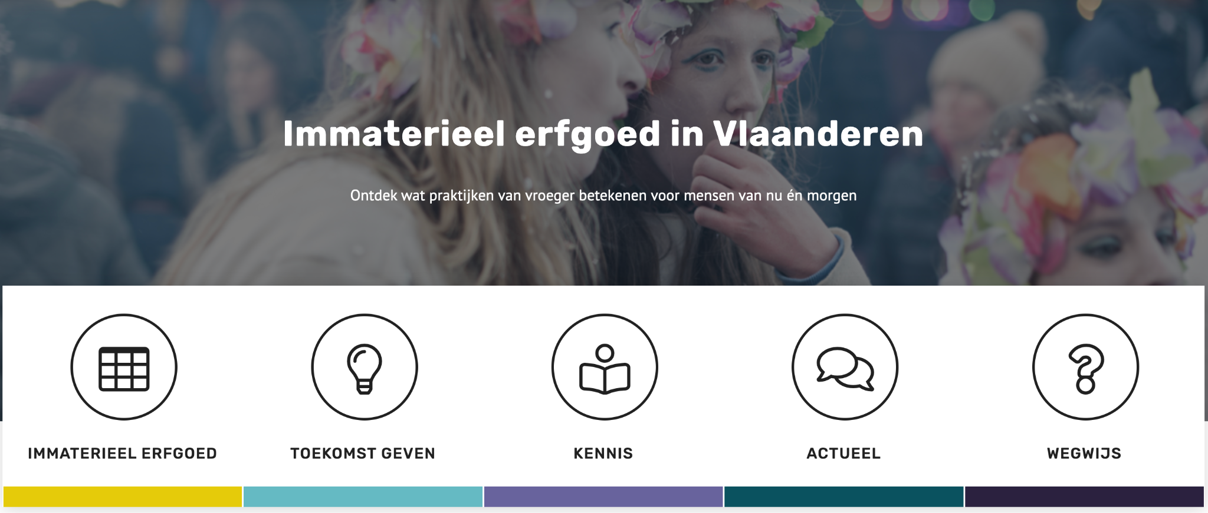
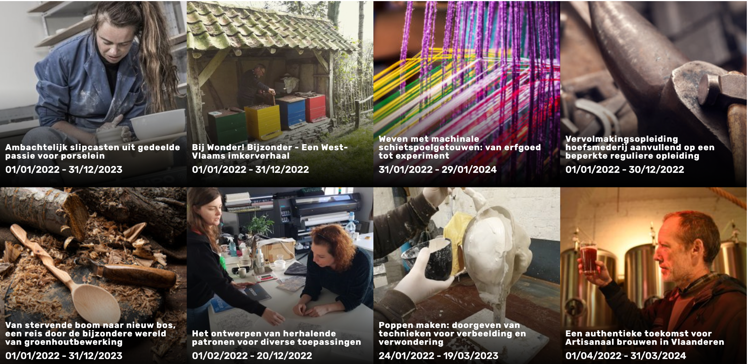
IMMATERIEELERFGOED.BE
Notes:
Inventaris als 1 van de vereisten na ratificatie van de conventie
Vlaamse casus
Participatieve registratie
Werkpraktijk eerste jaren van immaterieelerfgoed.be > descriptieve data, weinig gestructureerd
Nood aan toekomstbestendig maken > project om pURIs aan de webpagina’s toe te voegen
tension between the principles behind open data & persistentie on the one hand, and the stewardship of communities over their living and evolving ICH on the other > die spanning hebben we verder onderzocht & een reeks acties in het vooruitzicht gesteld om aan beide tegemoet te komen

Slide 38
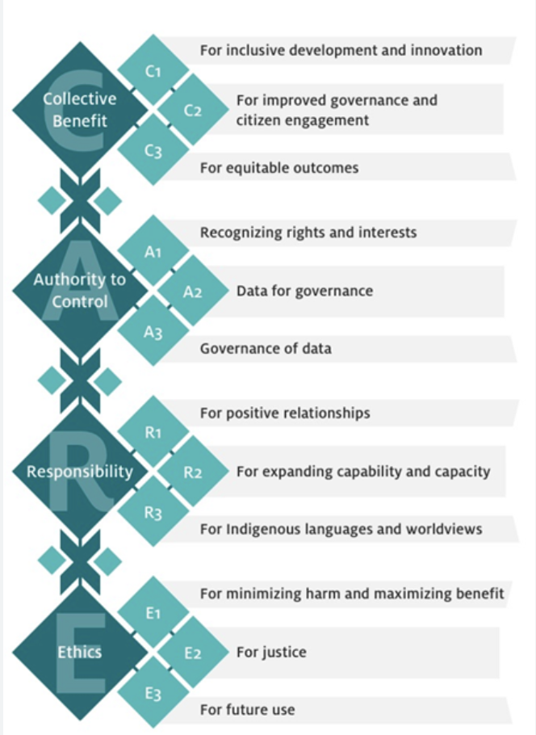
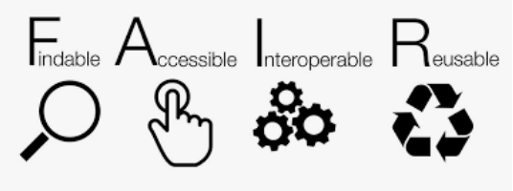
DATA LIFE CYCLE - FAIR - CARE
DATA LIFE CYCLE | FAIR | CARE
Collection building | Findable | Collective benefit
Interpretation of the data | Accessible | Authority to control
Data storage / preservation | Interoperable | Responsibility
Circulation | Reusable | Ethics
Reuse of data

Slide 39
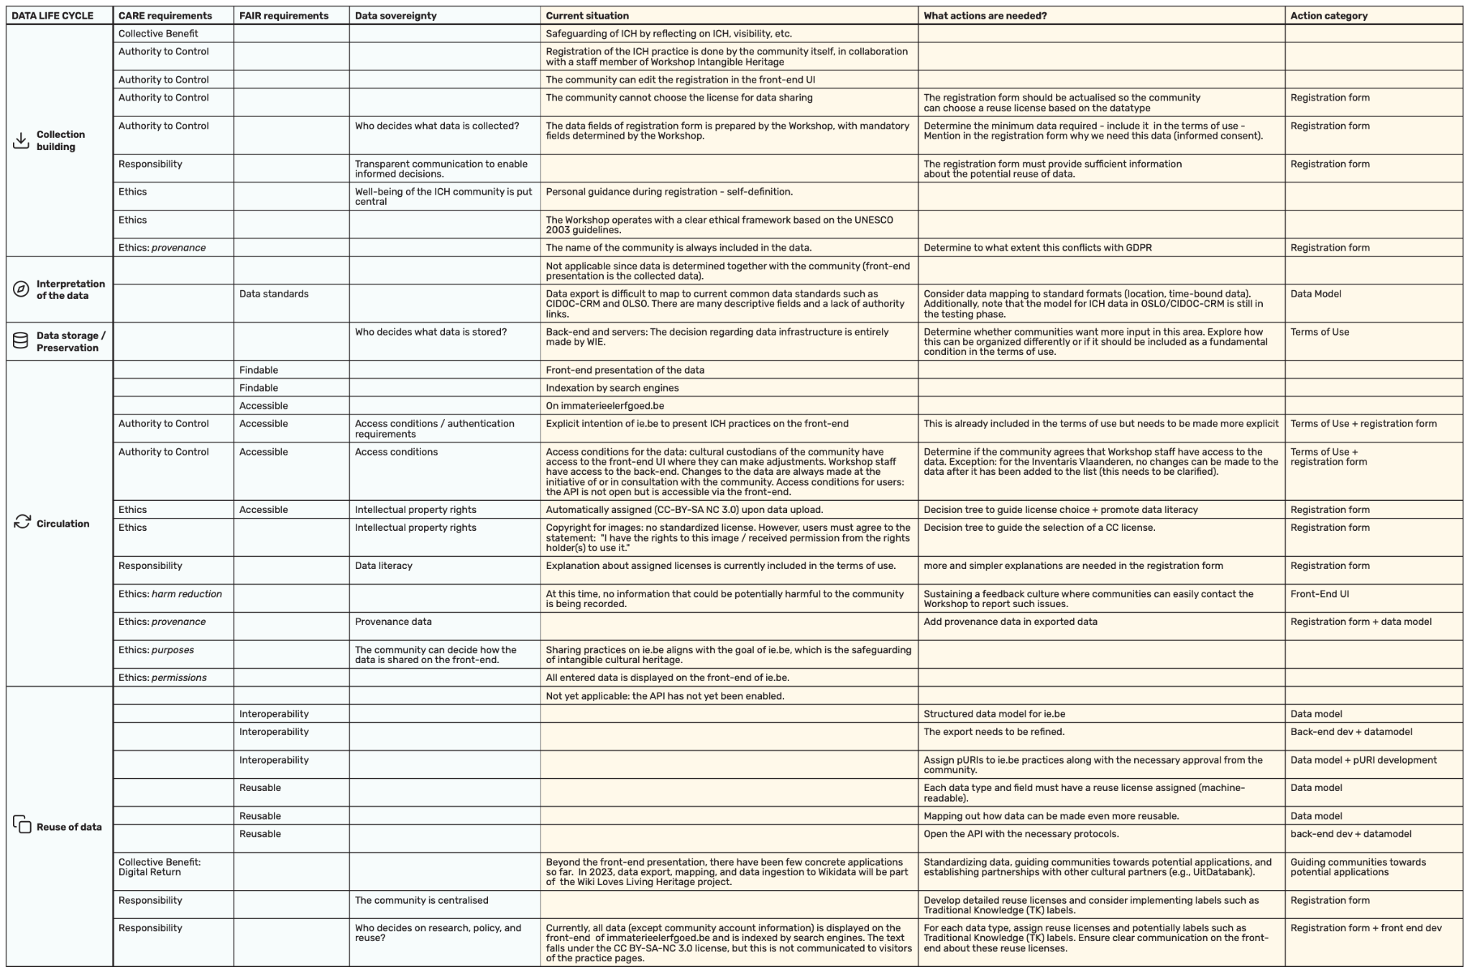
MATRIX & CASE STUDY
ADDITIONAL INFORMATION

Slide 40
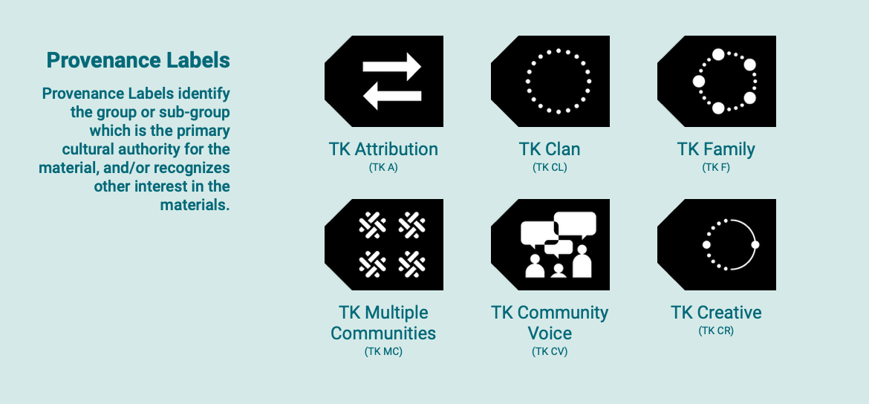
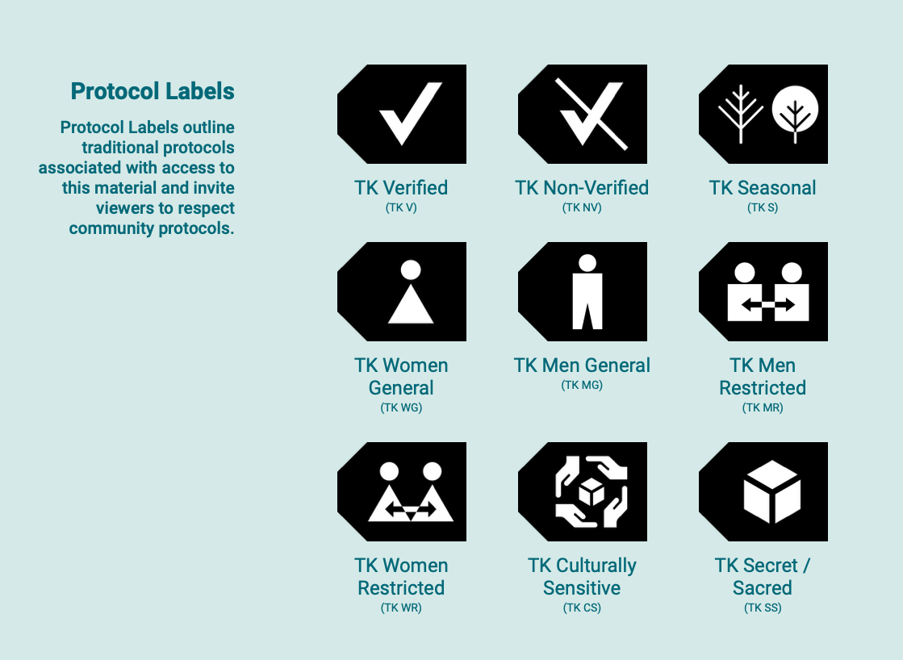
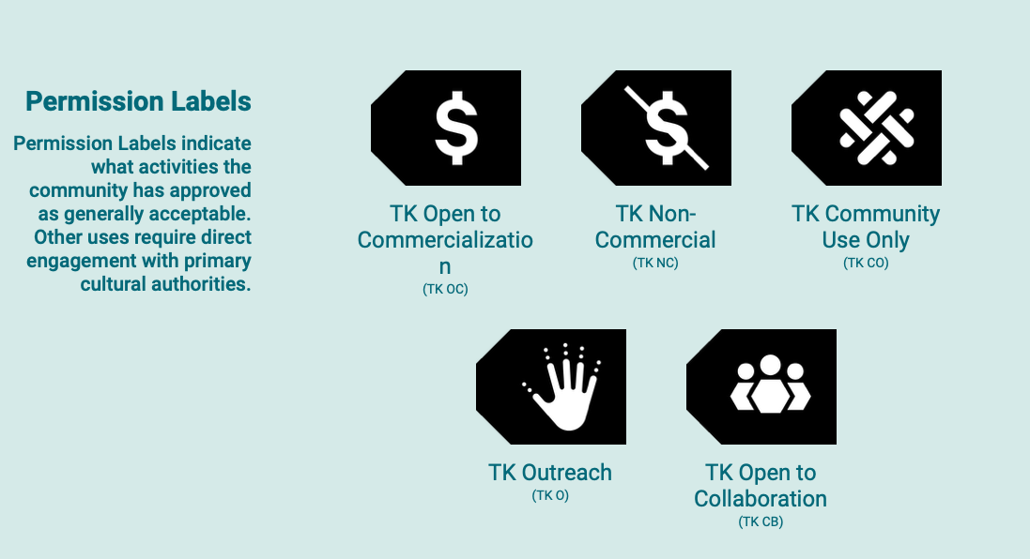
ACTIONS
REGISTRATION FORM pURI & opt out
TERMS OF USE AND PRIVACY POLICY
DATA MODEL
UX AND BACK END DEVELOPMENTS
LEGAL AND ETHICAL ASPECTS OF REUSING DATA Creative commons Traditional knowledge labels → dual licensing

Slide 41
With the FAIRxCARE matrix towards a pragmatic and user-friendly data practice
⇒ the impact of living heritage and the digital return strengthened
⇒ a transparent and ethical data strategy
⇒ making sure intangible heritage is and remains present in the digital world
with the agency of involved communities, groups and individuals at the center
…

Slide 42
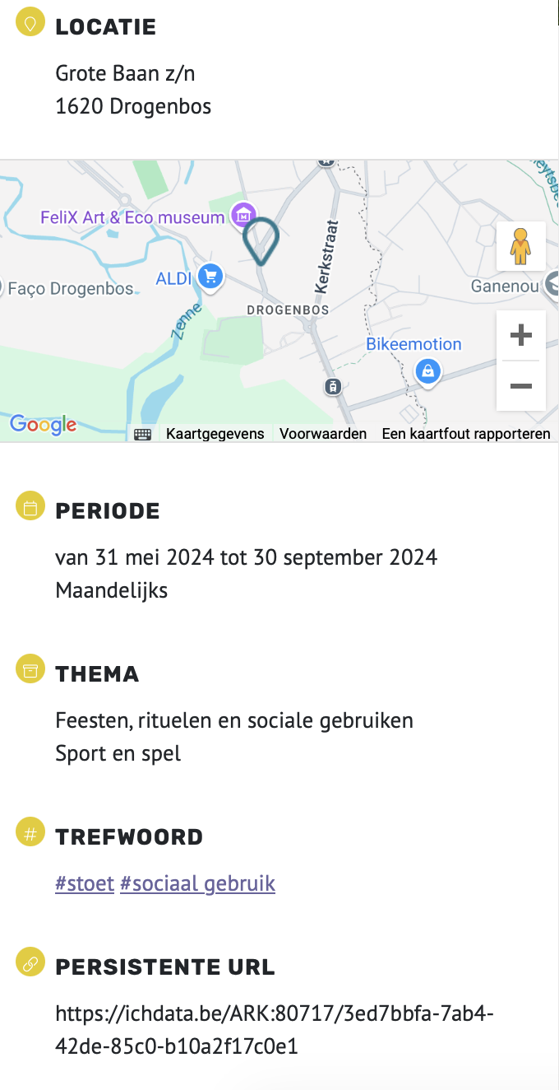

Slide 43
Bij FeliX Art & Eco Museum werd de praktijk als ‘object’ ingevoerd. De pURI komt dan bij de digitale referentie te staan:
RT / digital_reference.description
RF / digital_reference
De relaties met roerende erfgoedobjecten worden gelegd bij "gerelateerd object" (op hetzelfdetabblad). Daarnaast kunnen er makkelijk publicaties gelinkt worden met die erfgoedpraktijk (via documentatie).

Slide 44
FIRST THOUGHTS?

Slide 45
LUNCH BREAK

Slide 46
ROUND TABLE DISCUSSION

Slide 47
Cán museums register ICH in their collections?
Should museums register ICH in their collections? Or are there more suitable options?
What about connecting museums’ ICH-descriptions to other types of ICH-collections? Inventories, such as national inventories of ICH, archive collections, …?
Is the model proposed suitable?
How about application outside the Flemish / European context?
What is the best way to go forward?
What are your thoughts, ideas, comments?
Is it possible to aim for some sort of global standardization?
When is this work ‘finished’?

Slide 48
Shabnam Inanloo Dailoo, PhD, Associate Dean, Strategic Initiatives, Director / Associate Professor, Heritage Resources Management Program, Faculty of Humanities and Social Sciences, Athabasca University:
“Thank you again for sharing this draft document with me. I got a chance to browse through it with a few of my students and we thought it is a useful document to start thinking about such a documentation process within the Canadian context. We do not have any detailed feedback to offer but were wondering about how this document would be applicable to the documentation of the intangible values of Indigenous belongings and how it could incorporate Indigenous protocols.
It is critical to consider this document from a non-Western perspective and understand its application outside of Europe. The main question is how flexible and context-based the international standard could be. Understandably, the technical details could and should be applicable more broadly. These are just some general comments that I thought to share.
I would be very much interested to know, if possible, the type of communities who provided feedback and the nature of feedback you have received.This exercise was timely for me. I will be travelling with my students to South Africa and Lesotho this November. We will be working with students and faculty at the National University of Lesotho, Ministry of Tourism, Environment, and Culture, and a local community and prepare nomination files for two Intangible Cultural Heritage elements for Lesotho, their first nomination proposals under the 2003 UNESCO ICH Convention. This is an exciting opportunity for us to learn first-hand about the nomination process while working with the community, especially because Canada is not a signatory of the ICH Convention.”

Slide 49
Katie Kennedy, Curator, Northumberland County Archives & Museum
“Thank you for sharing the Intangible Cultural Heritage application profile. I found it both informative and interesting to read. While I don't have any significant feedback on the content itself, I did notice a formatting issue on page 61, Section 4.1.3, where the chart image overlaps with the paragraph text.
As I reviewed the document, I reflected on how we might implement these cataloguing standards in our museum’s practices. Your flow charts are straightforward, the categories and names are clear and would be simple to implement. Where I personally struggle is the actual identification of ICH in communities in our rural farming County (excluding Indigenous Community). There are overt examples of ICH similar to those used in your document, but in many instances, I find the ICH difficult to specify and break down in a description. I would welcome any resources and discussion your working group have supporting this work. Our goal is to support ICH strength between generations within all Northumberland communities without us necessarily acquiring physical materials. An ICH artefact would be carefully considered only if the creating community wanted us to have it and all efforts to house it within community had been exhausted. Identifying which artefacts are even appropriate for housing or display would also be a significant dialogue to have as ceremonial, spiritual, or other materials may not ever be suitable for museum storage or display. We are in the fortunate position of being a newer museum with a small collection, so can move forward making sensitive and informed decisions on acquisitions. I’m eager to see how these standards will be applied and am grateful for the opportunity to deepen my understanding of ICH through this process.”

Slide 50
Meg Preston, Digitization Coordinator, PEI Museum and Heritage Foundation:
“I’ve read through the ICH application profile. I didn’t have many comments but overall I think that creating a quantifiable process for cataloging of ICH is very exciting. I’ll be very curious to see what developments are made.”
Canadian Heritage Information Network (CHIN) – comments in Google Doc
Canadian Association for the Performing Arts (CAPACOA)- comments in Google Doc
Tanya Richard, Advisor, Cultural Heritage, Policy and Government Relations, Indigenous Portfolio, Canadian Museum of History, Canadian War Museum -

